Slide 1
Student Name : Srikanth Jammula
Email : srikanthjam21@gmail.com
College : Madanapalle Institute of Technology & Science
Internship Domain : Artificial Intelligence
Internship duration : 2months
Project Title : Car Price Prediction

Slide 2
Car Price Prediction
Table of Contents
Problem Statement
Import modules
Data checks to perform
Exploratory data analysis
Data pre-processing
Train the model
Model performance
Model Ranking

Slide 3
Car Price Prediction
Problem Statement
A Chinese automobile company Geely Auto aspires to enter the US market by setting up their manufacturing unit there and producing cars locally to give competition to their US and European counterparts.
They have contracted an automobile consulting company to understand the factors on which the pricing of cars depends. Specifically, they want to understand the factors affecting the pricing of cars in the American market, since those may be very different from the Chinese market. The company wants to know:
- Which variables are significant in predicting the price of a car
How well those variables describe the price of a car
Based on various market surveys, the consulting firm has gathered a large dataset of different types of cars across the Americal market.
Business Goal
You are required to model the price of cars with the available independent variables. It will be used by the management to understand how exactly the prices vary with the independent variables. They can accordingly manipulate the design of the cars, the business strategy etc. to meet certain price levels. Further, the model will be a good way for management to understand the pricing dynamics of a new market.

Slide 4
Learn About Data
CarID: Identification Number for Each Car
SafetyRating: Car's Safety Rating
CarName: Name of the Car Model
FuelType: Type of Fuel Used (Gasoline, Diesel, Electric, etc.)
Aspiration: Type of Aspiration (Standard or Turbocharged)
NumDoors: Number of Doors on the Car
BodyStyle: Style of the Car's Body (Sedan, Coupe, SUV, etc.)
DriveWheelType: Type of Drive Wheels (Front, Rear, All)
EngineLocation: Location of the Car's Engine (Front or Rear)
Wheelbase: Length of the Car's Wheelbase
CarLength: Overall Length of the Car
CarWidth: Width of the Car
CarHeight: Height of the Car
CurbWeight: Weight of the Car without Passengers or Cargo

Slide 5
EngineType: Type of Engine (Gas, Diesel, Electric, etc.)
NumCylinders: Number of Cylinders in the Engine
EngineSize: Size of the Car's Engine
FuelSystem: Type of Fuel Delivery System
BoreRatio: Bore-to-Stroke Ratio of the Engine
Stroke: Stroke Length of the Engine
CompressionRatio: Compression Ratio of the Engine
Horsepower: Car's Engine Horsepower
PeakRPM: Engine's Peak RPM (Revolutions Per Minute)
CityMPG: Miles Per Gallon (MPG) in City Driving
HighwayMPG: MPG on the Highway
CarPrice: Price of the Car

Slide 6
Life cycle of Machine Learning Project
Understanding the Problem Statement
Data Checks to Perform
Exploratory Data Analysis
Data Pre-Processing
Model Training
Choose Best Model

Slide 7
1.Problem Statement
Predicting the price of cars based on a wide range of attributes and features. Using a dataset containing car details such as safety ratings, dimensions, engine specifications, and more, we aim to develop a machine learning model that accurately estimates the price of different car models.

Slide 8
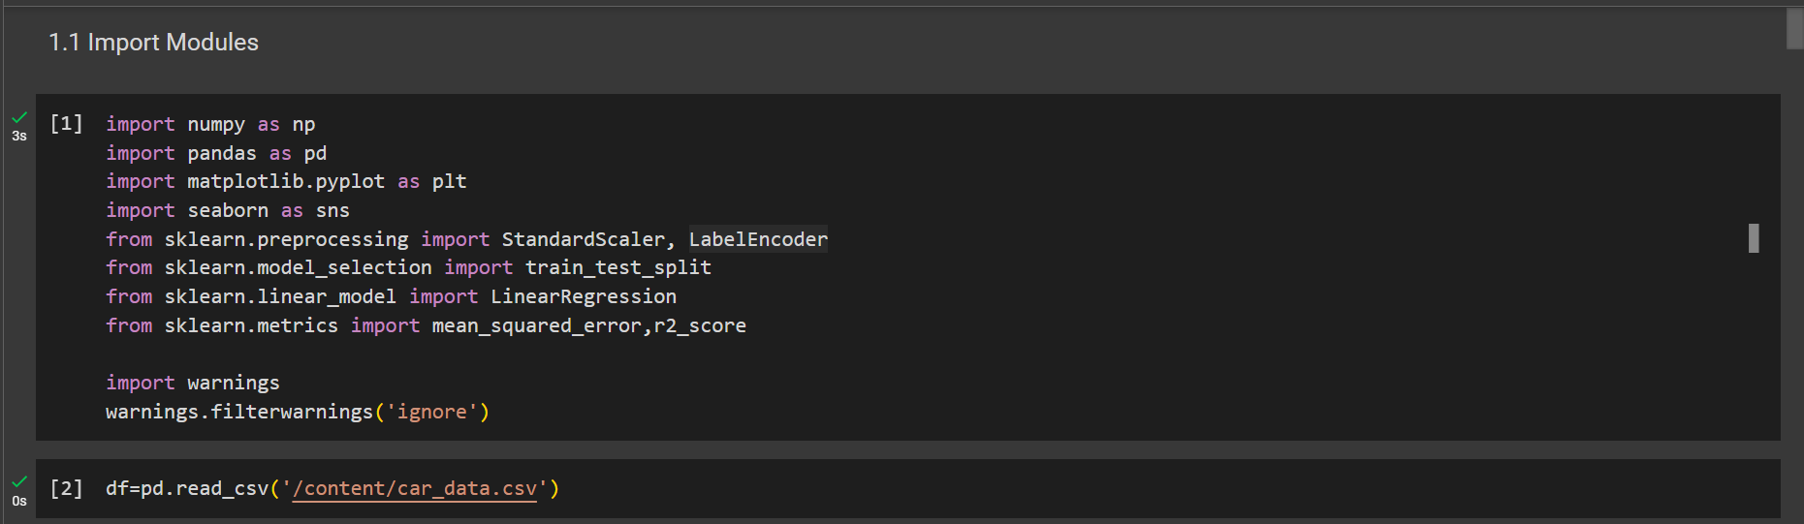
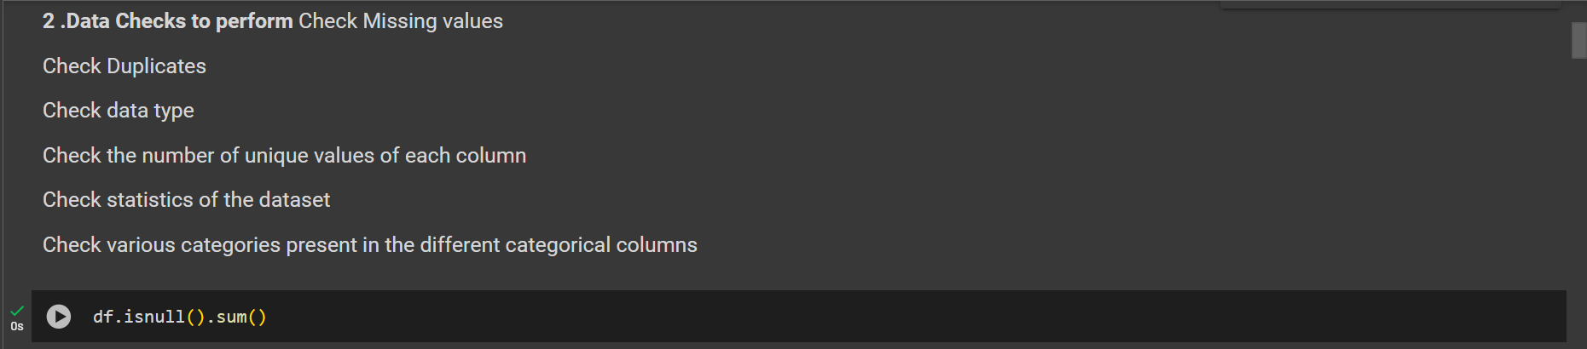

Slide 9
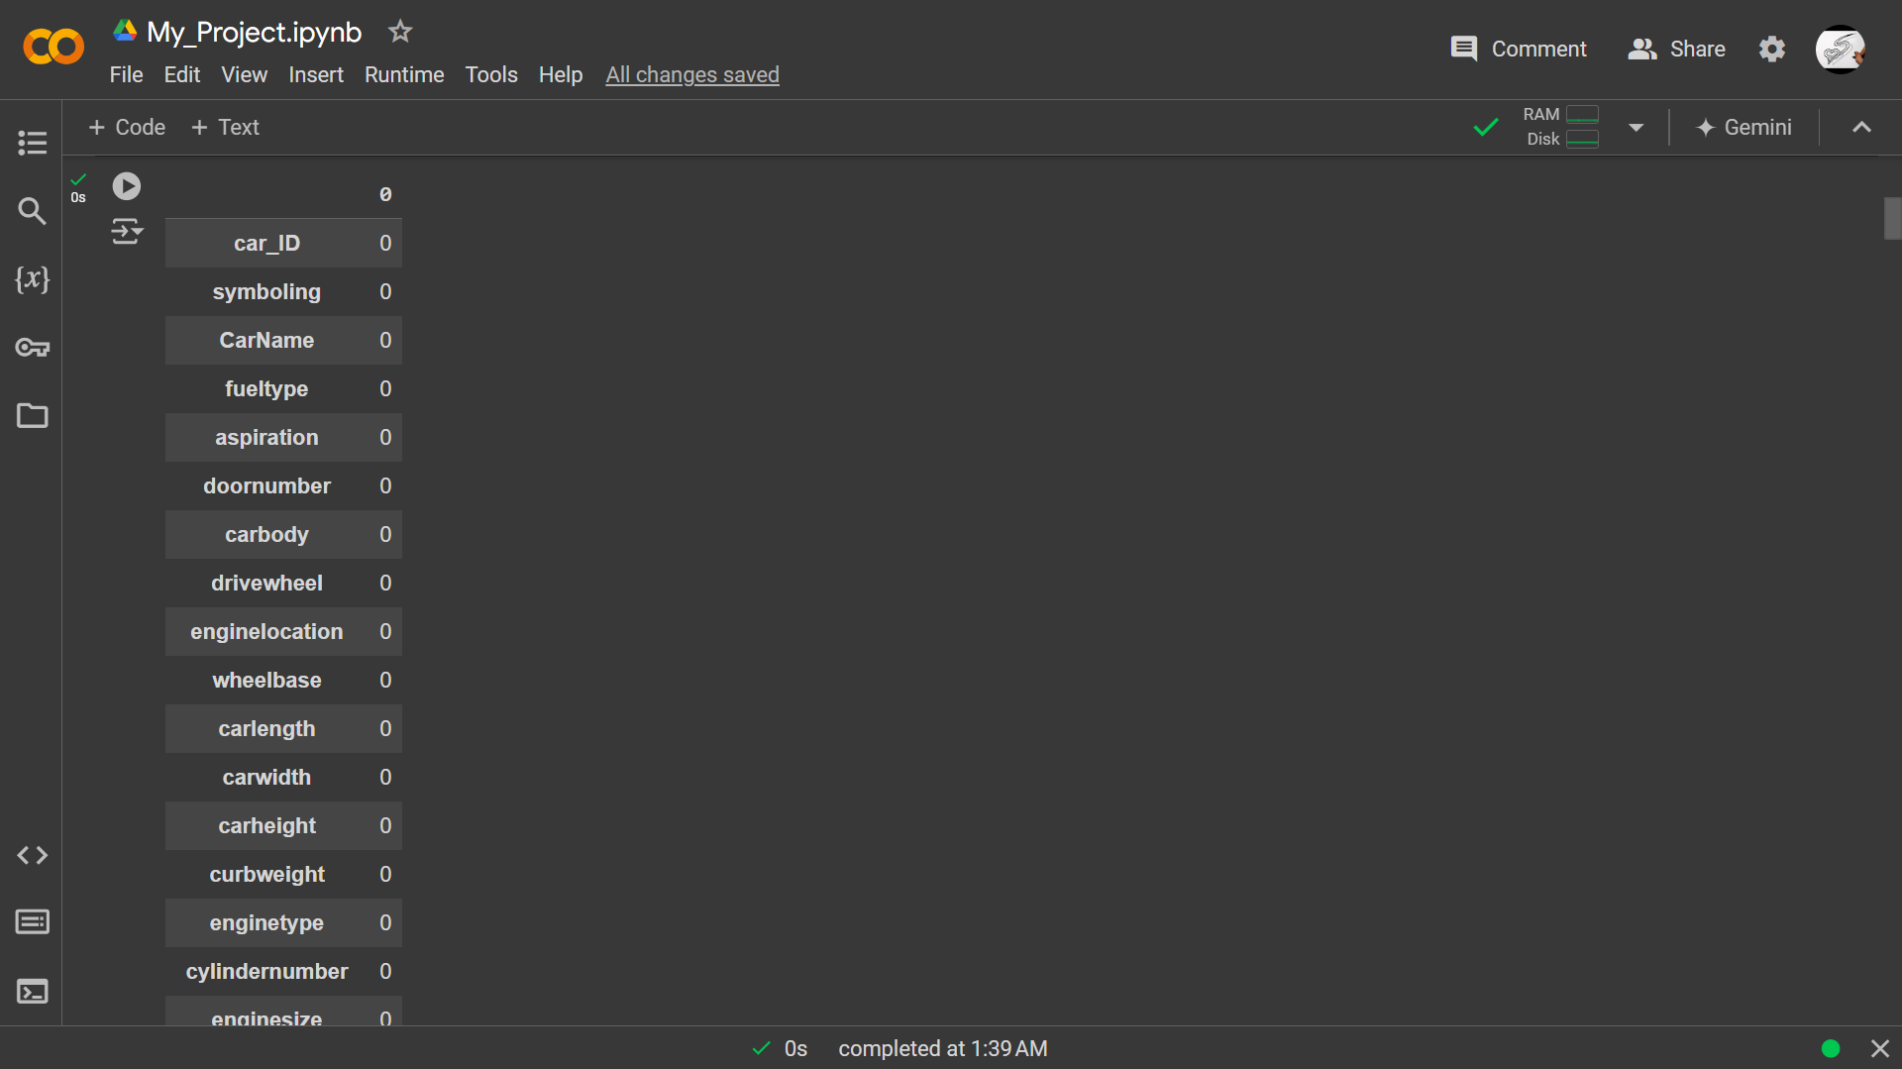
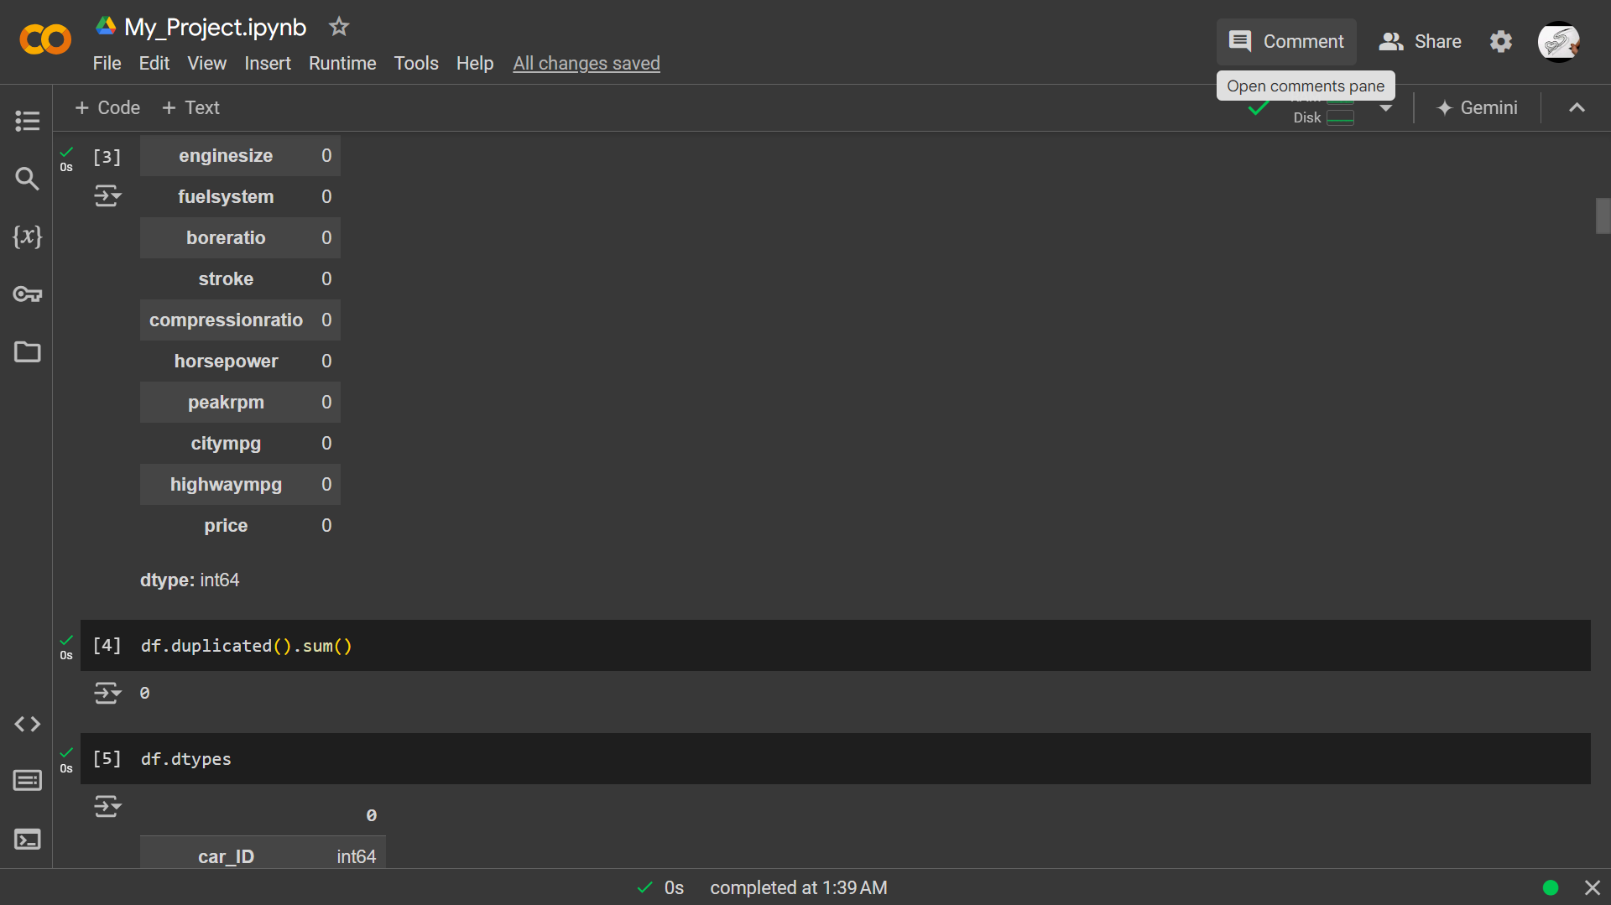

Slide 10
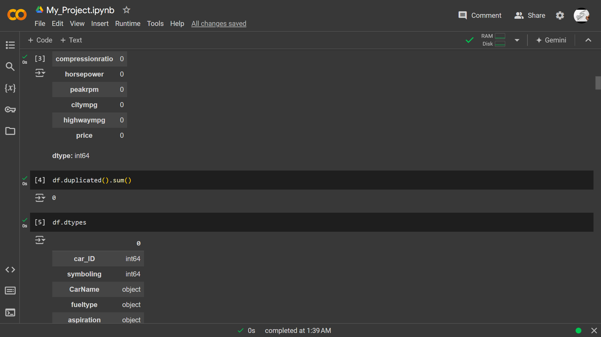
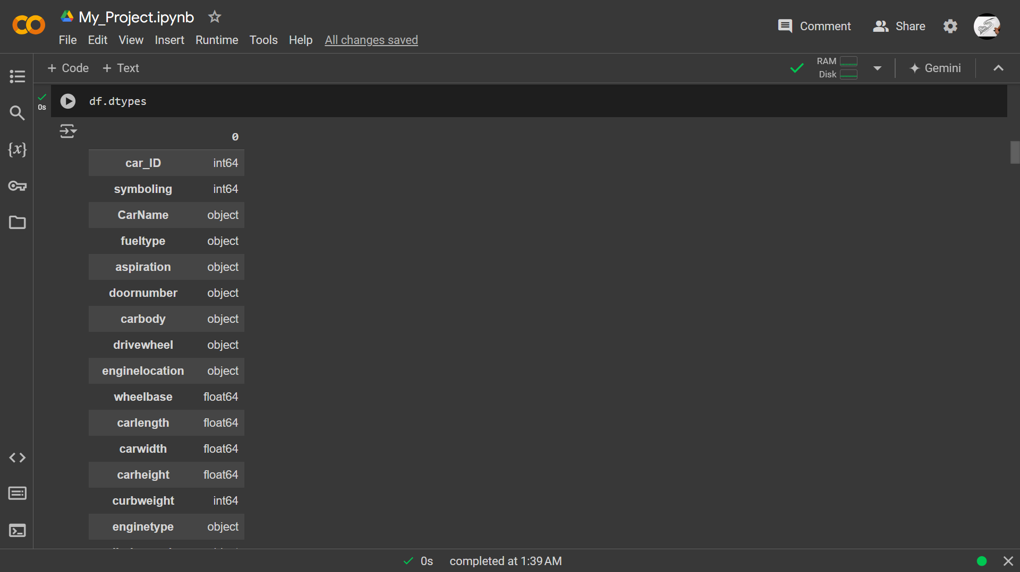

Slide 11
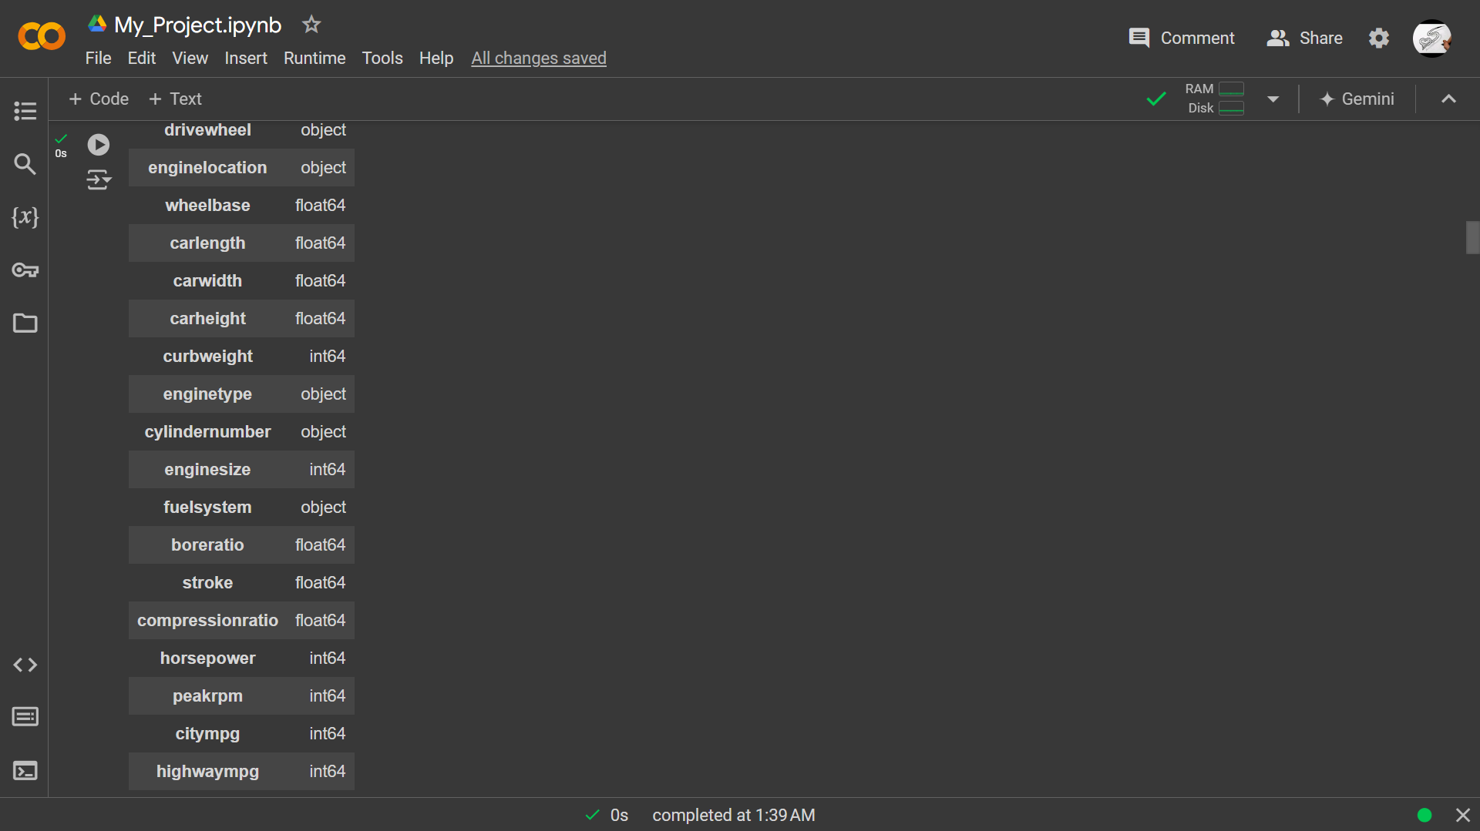
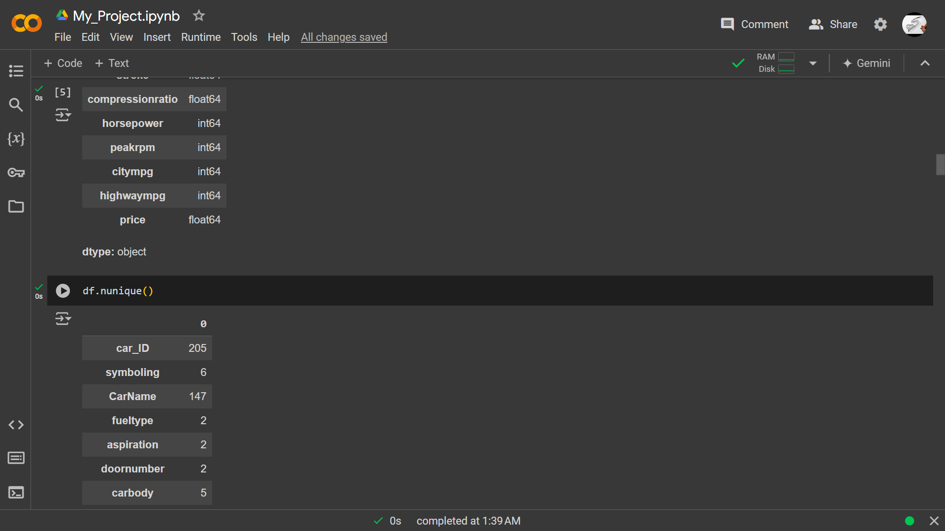

Slide 12
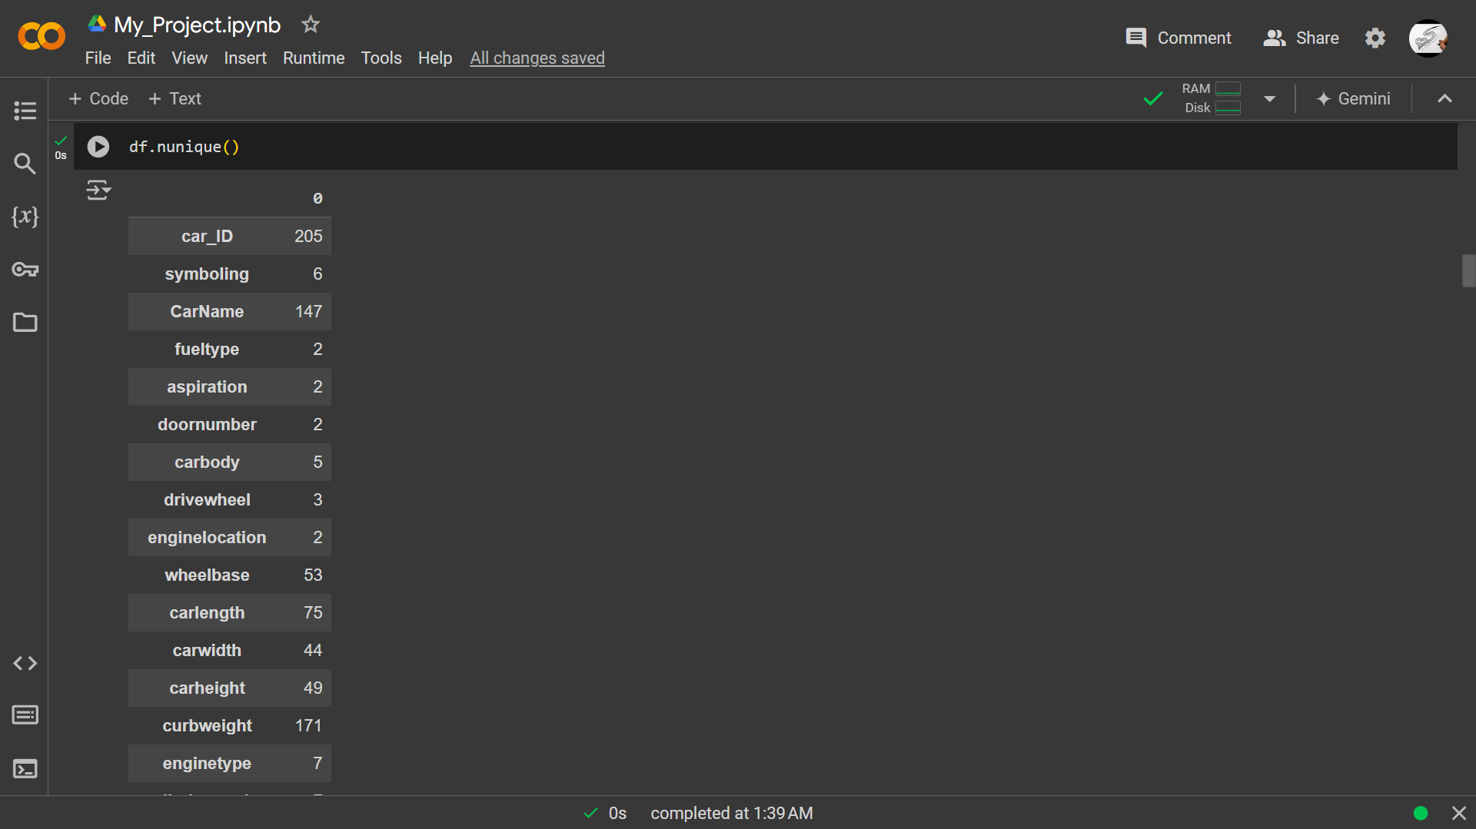
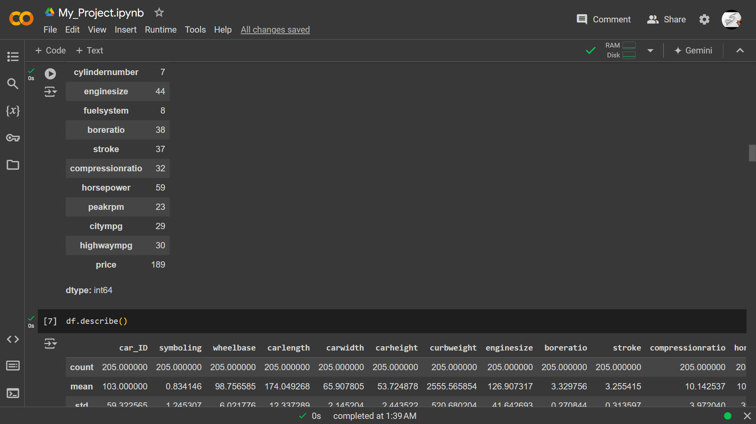

Slide 13
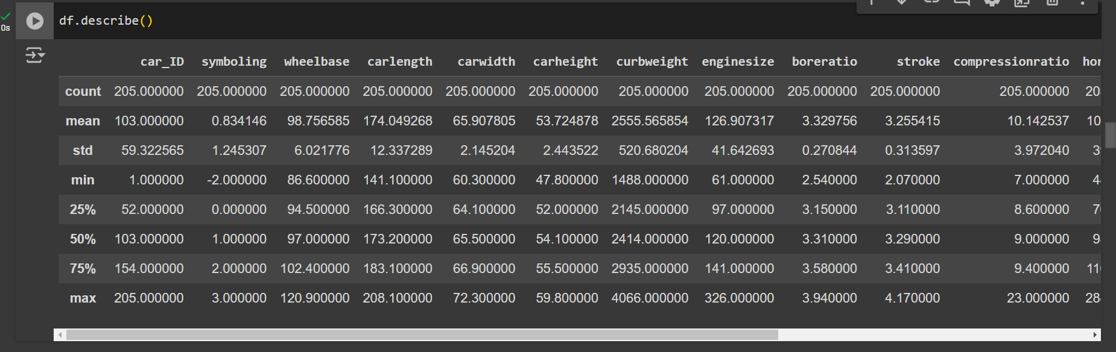
Insights from Statistics:
Car Variety 🚗🚙:
Dataset covers 205 car models, each unique in attributes.
Sizes, weights, and engine capacities vary across cars.
Price Range 💰:
Mini Price: 5,118 dollar
Maxi Price: 45,400 dollar
Average car price is about $13,276.

Slide 14
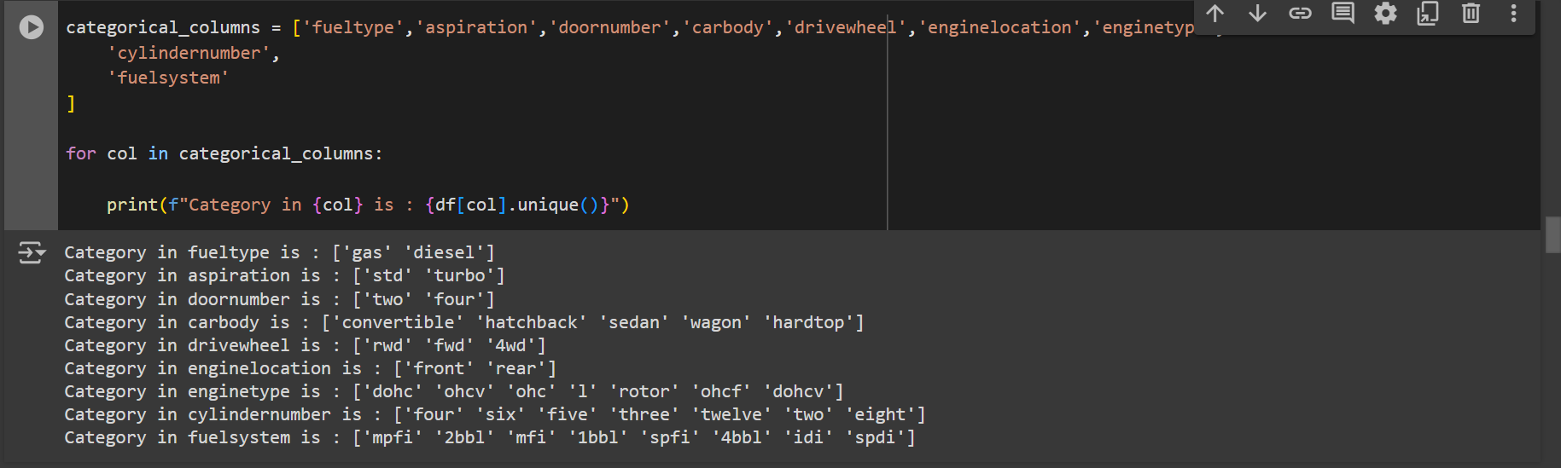
3.Engine Diversity 🛠️:
Risk ratings (symboling) vary from -2 to 3.
Engines differ in bore diameter (boreratio) and stroke length (stroke).
4.Data Distribution 📊:
Features like carwidth, curbweight, enginesize show notable variability.
Potential outliers present in compressionratio and horsepower

Slide 15
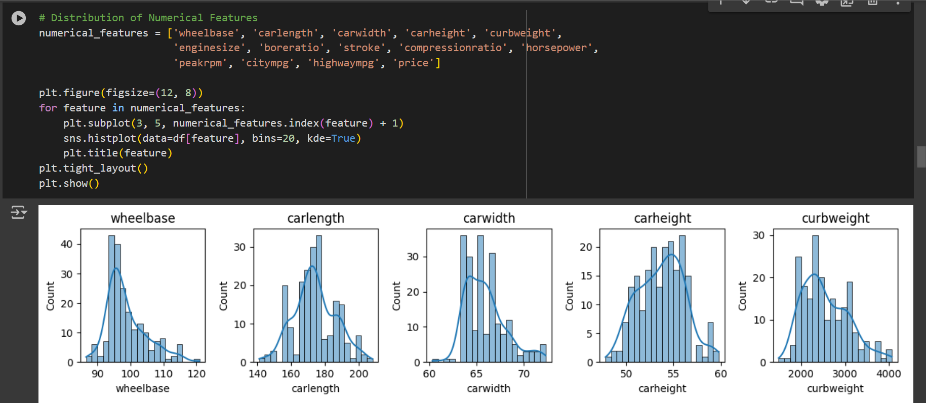
3.Exploratory Data Analysis

Slide 16
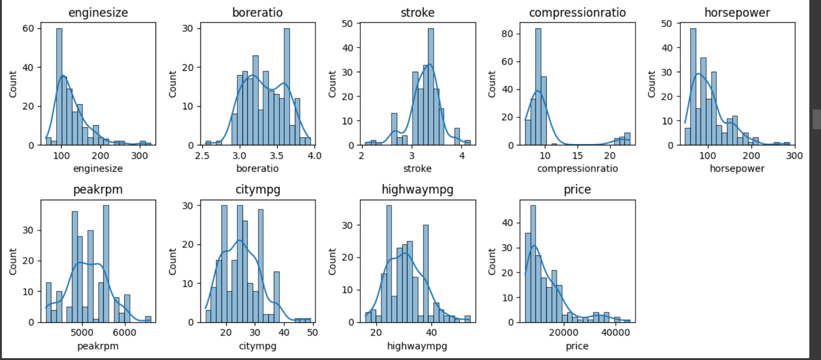

Slide 17
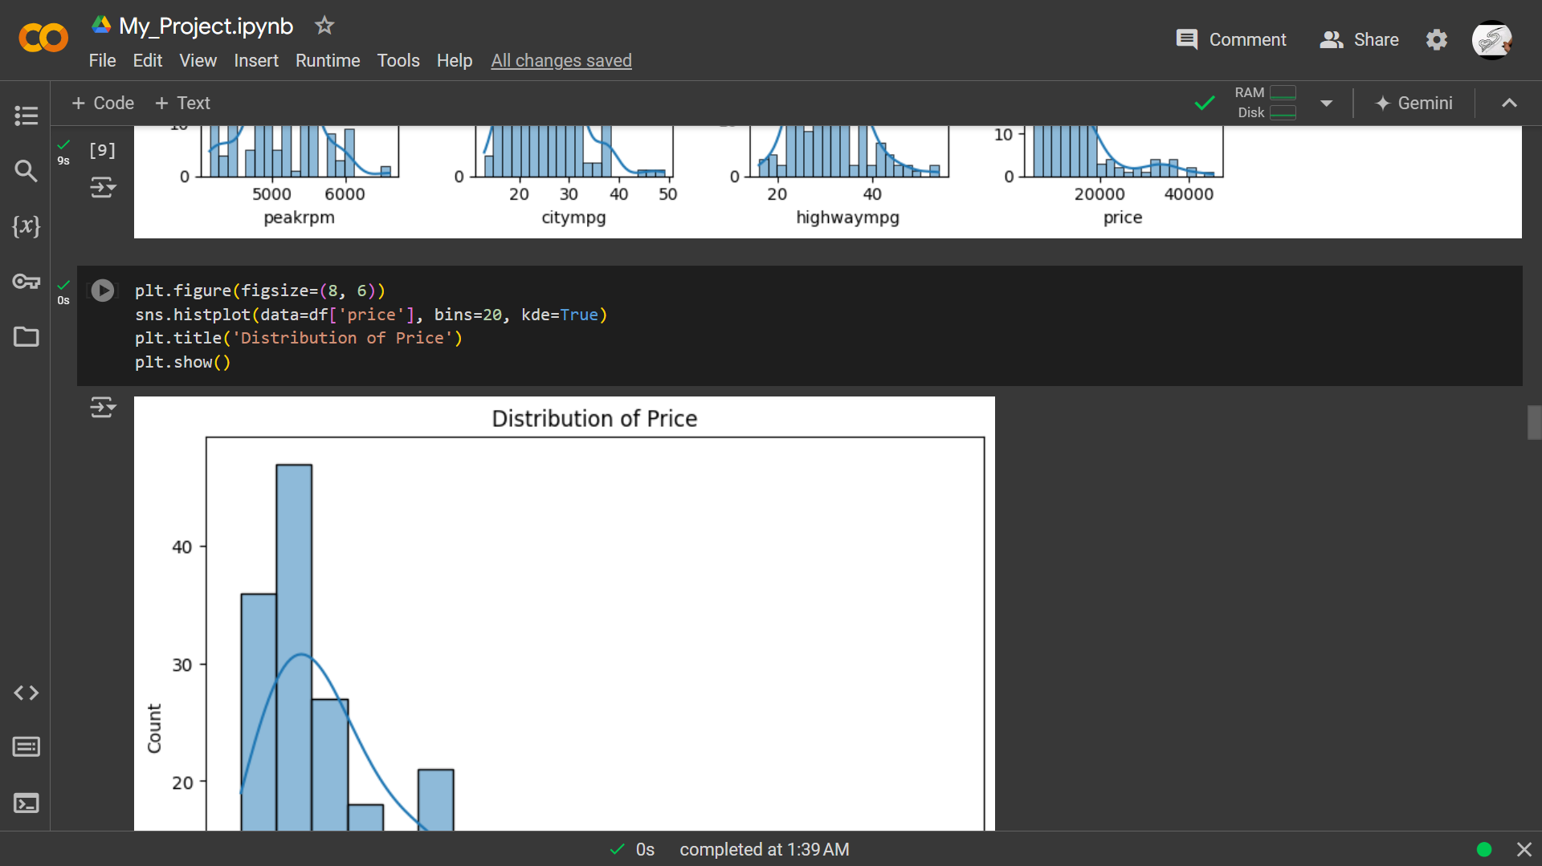
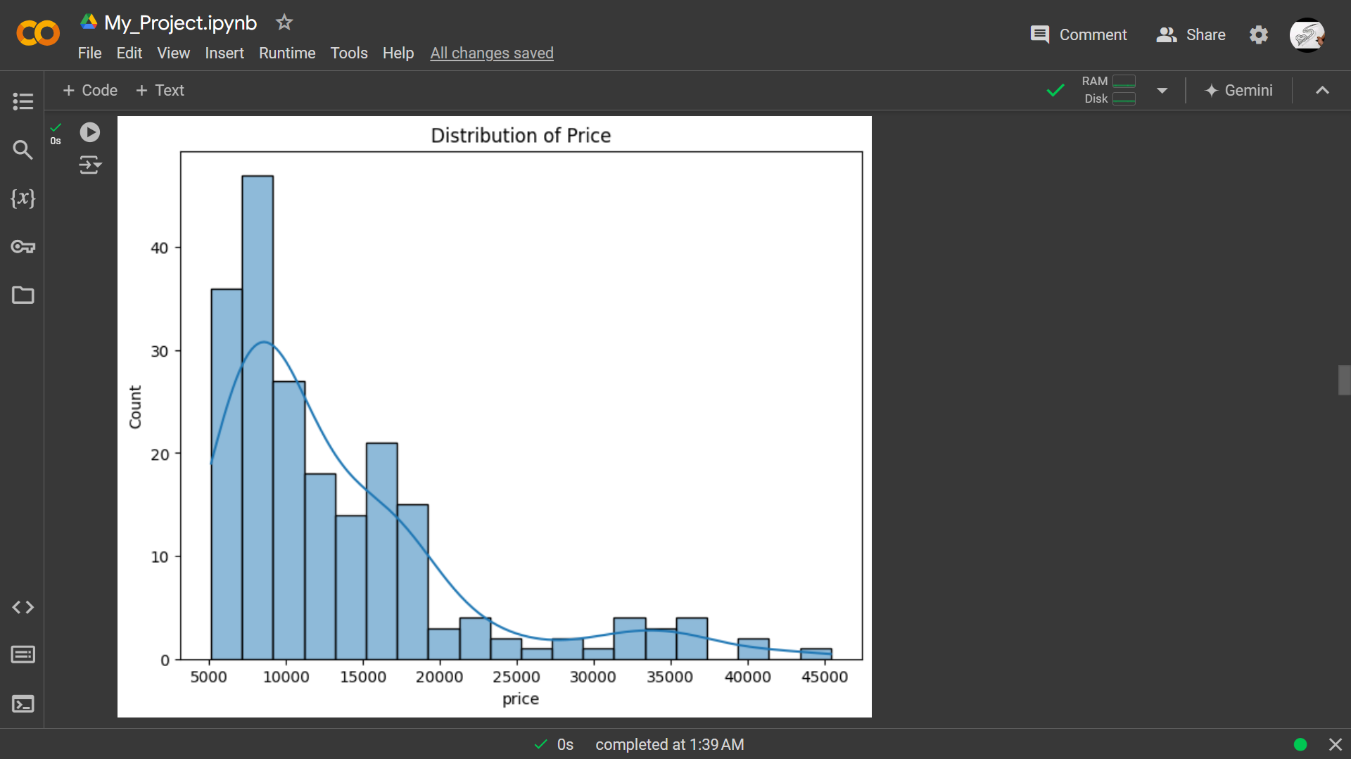

Slide 18
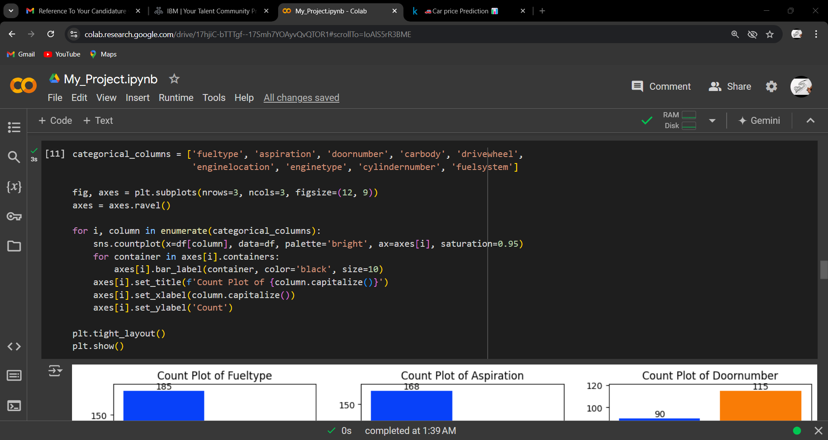
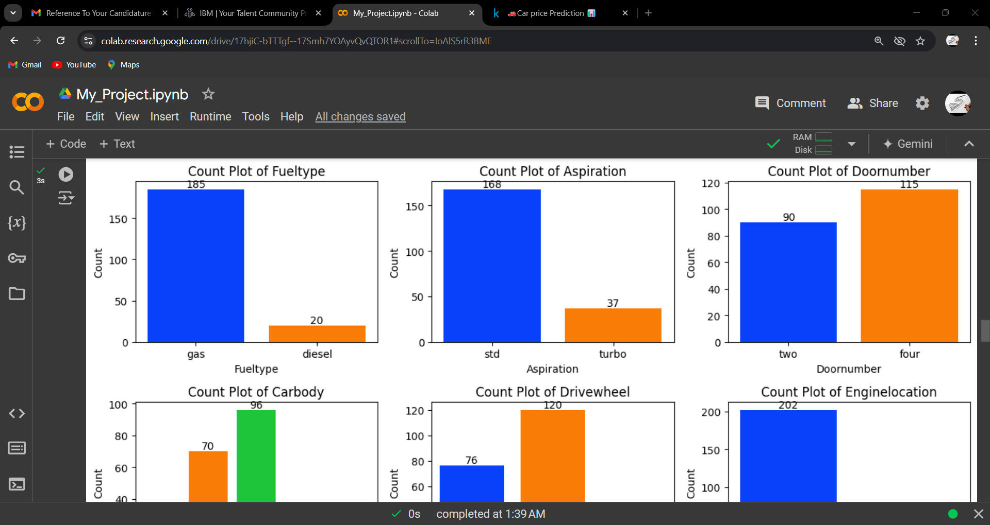

Slide 19
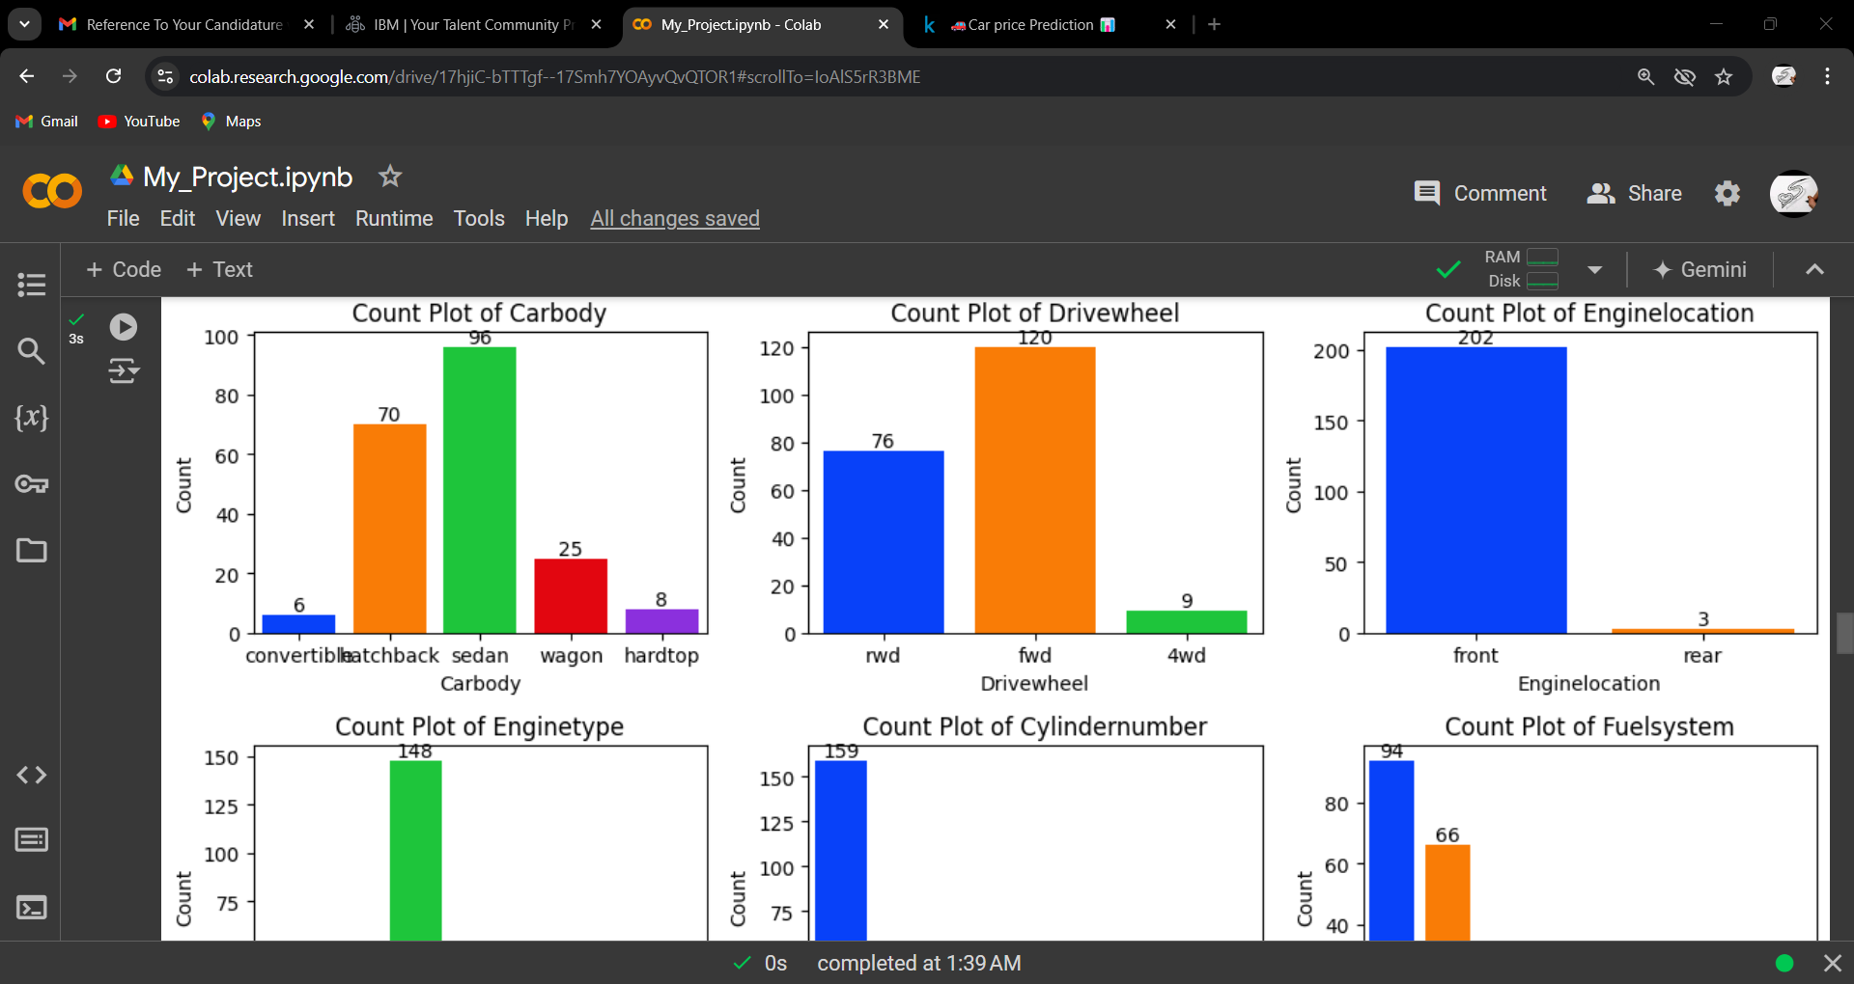
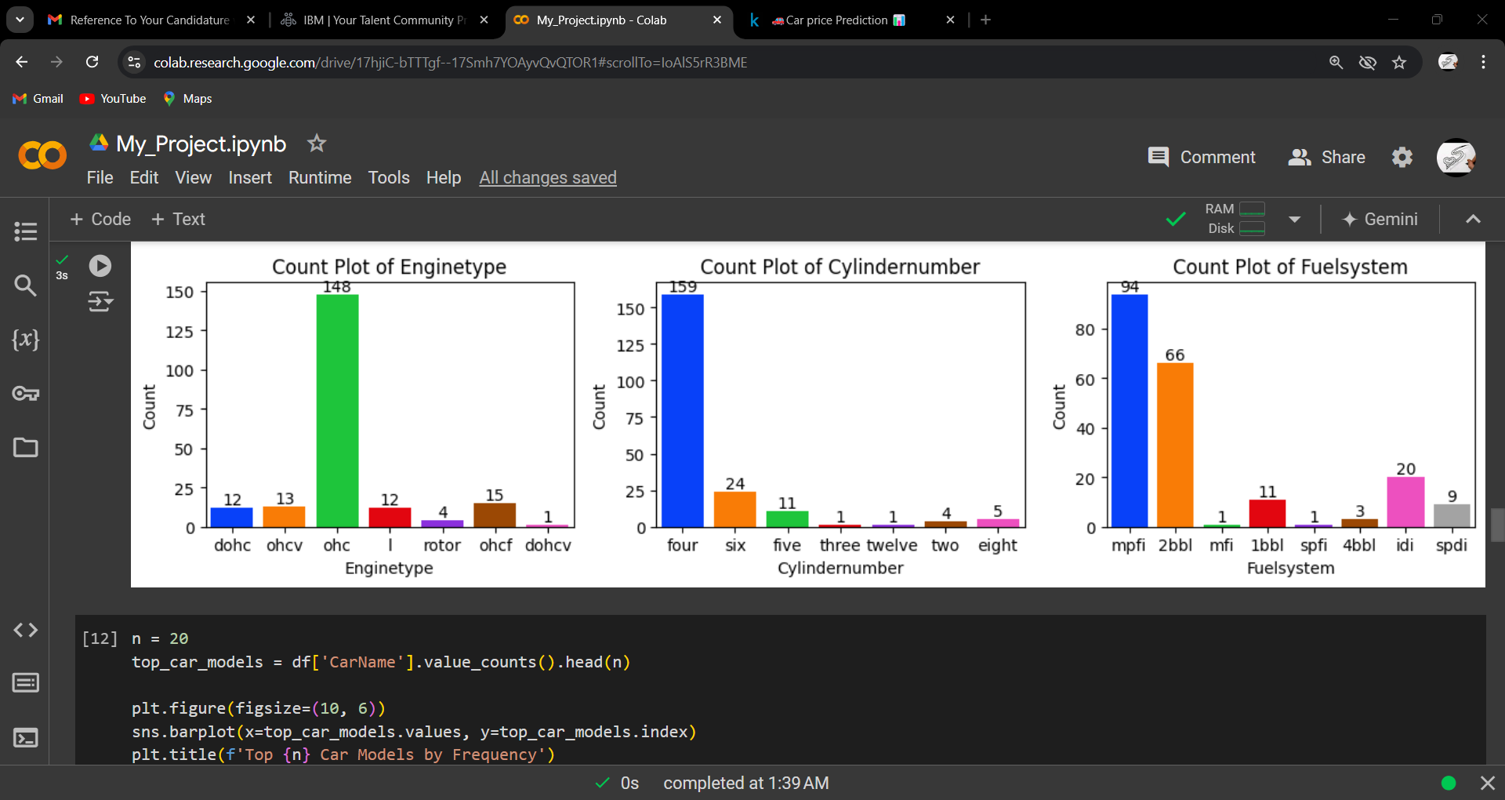

Slide 20
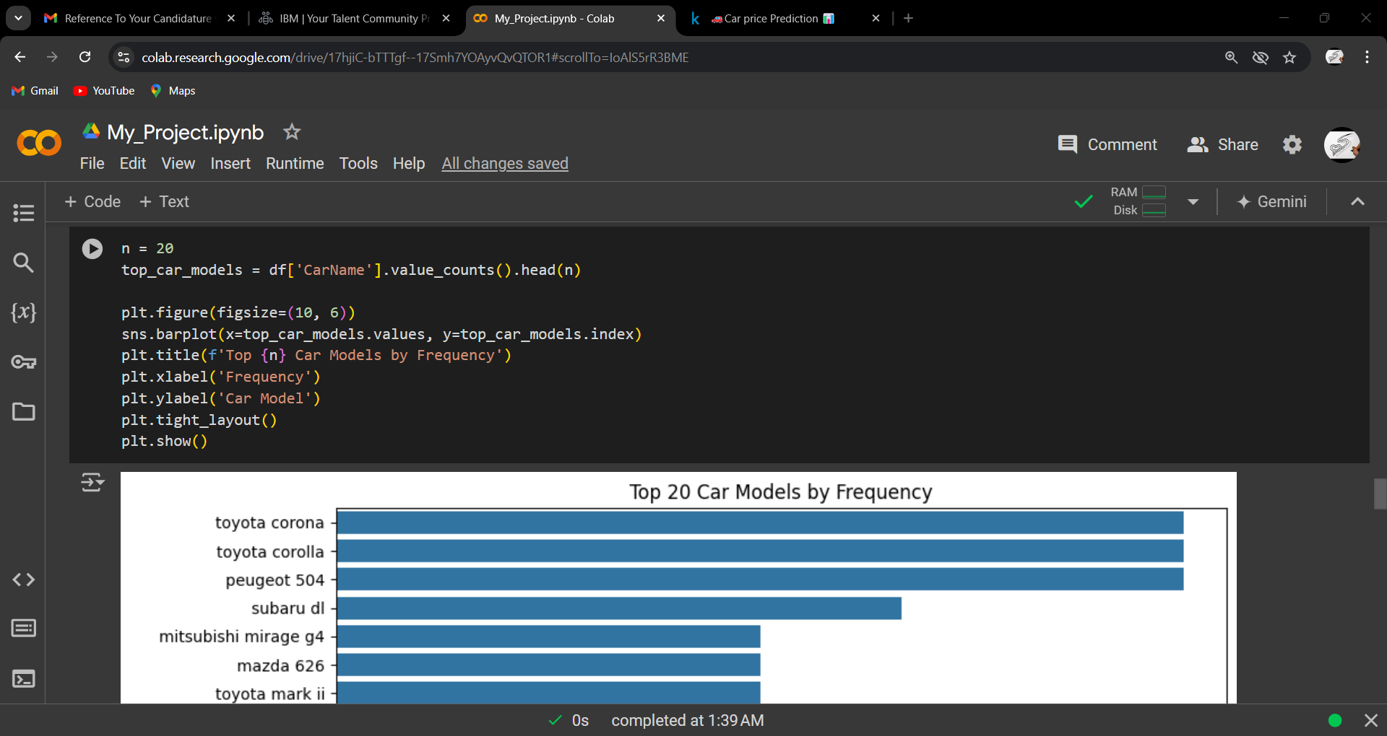
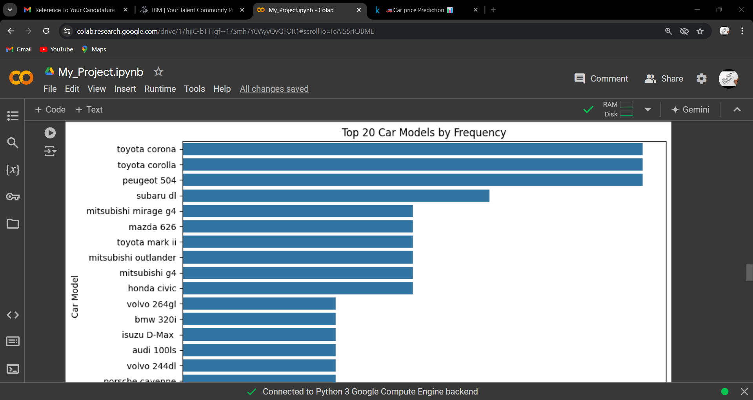

Slide 21
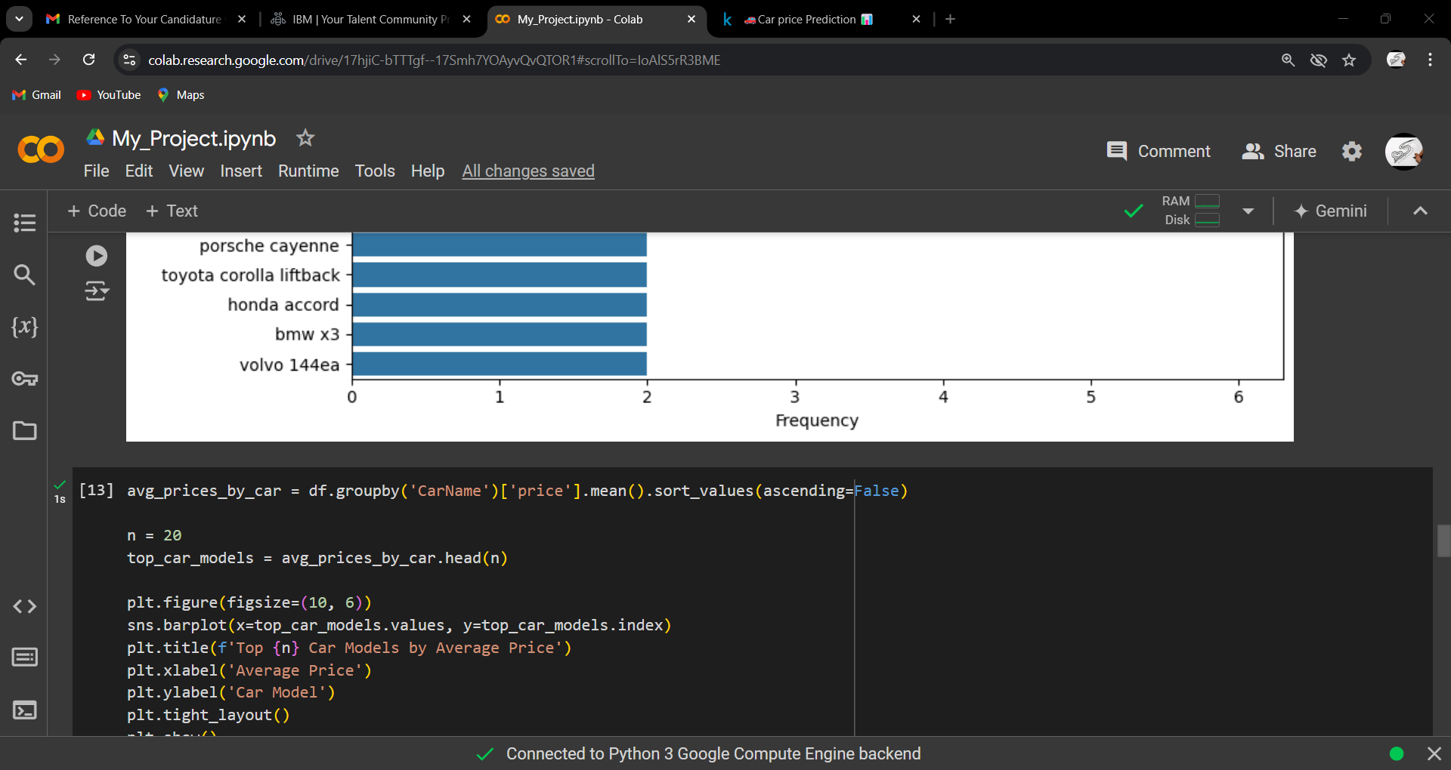
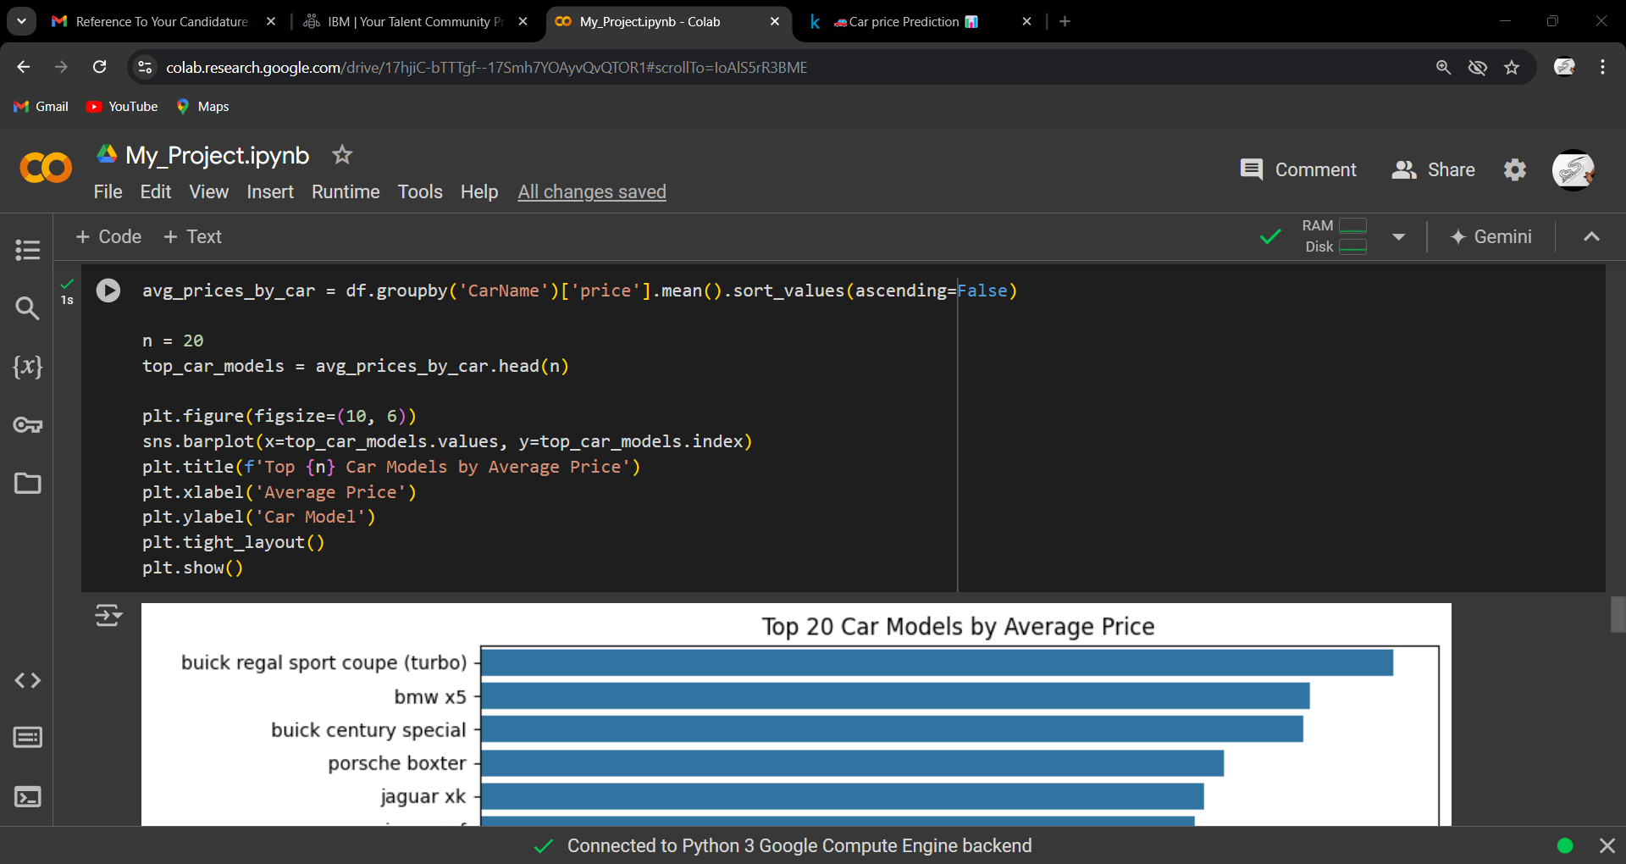
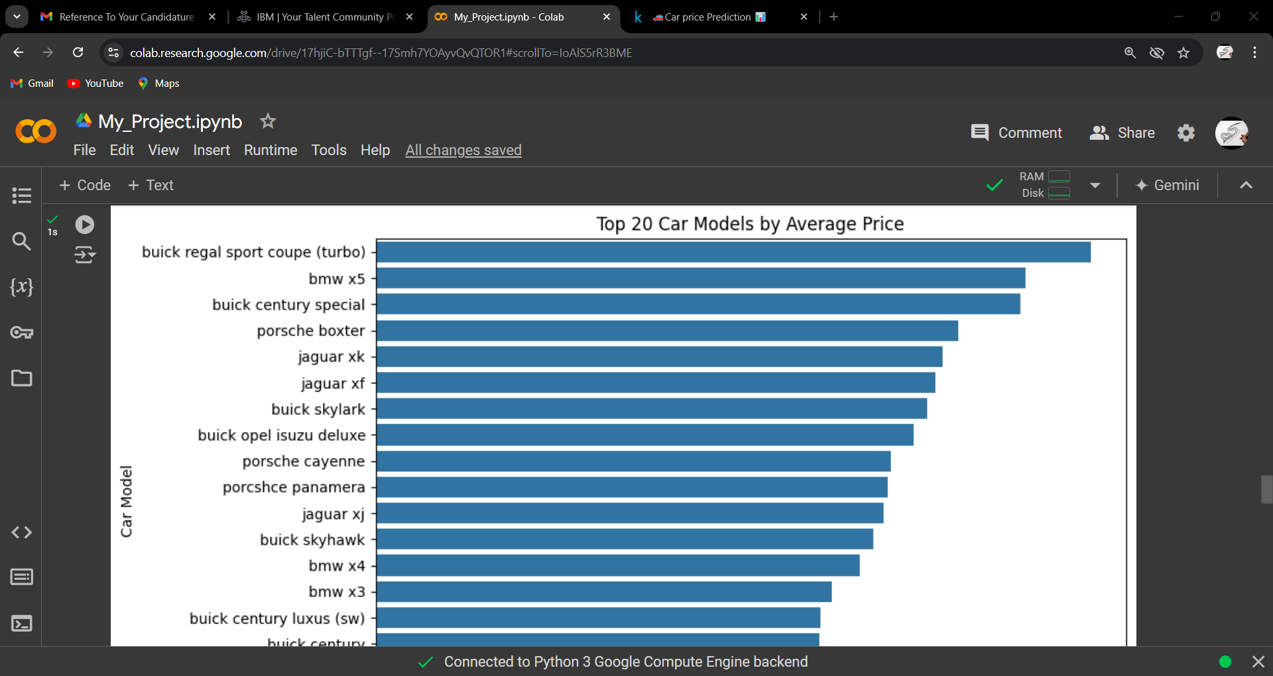

Slide 22
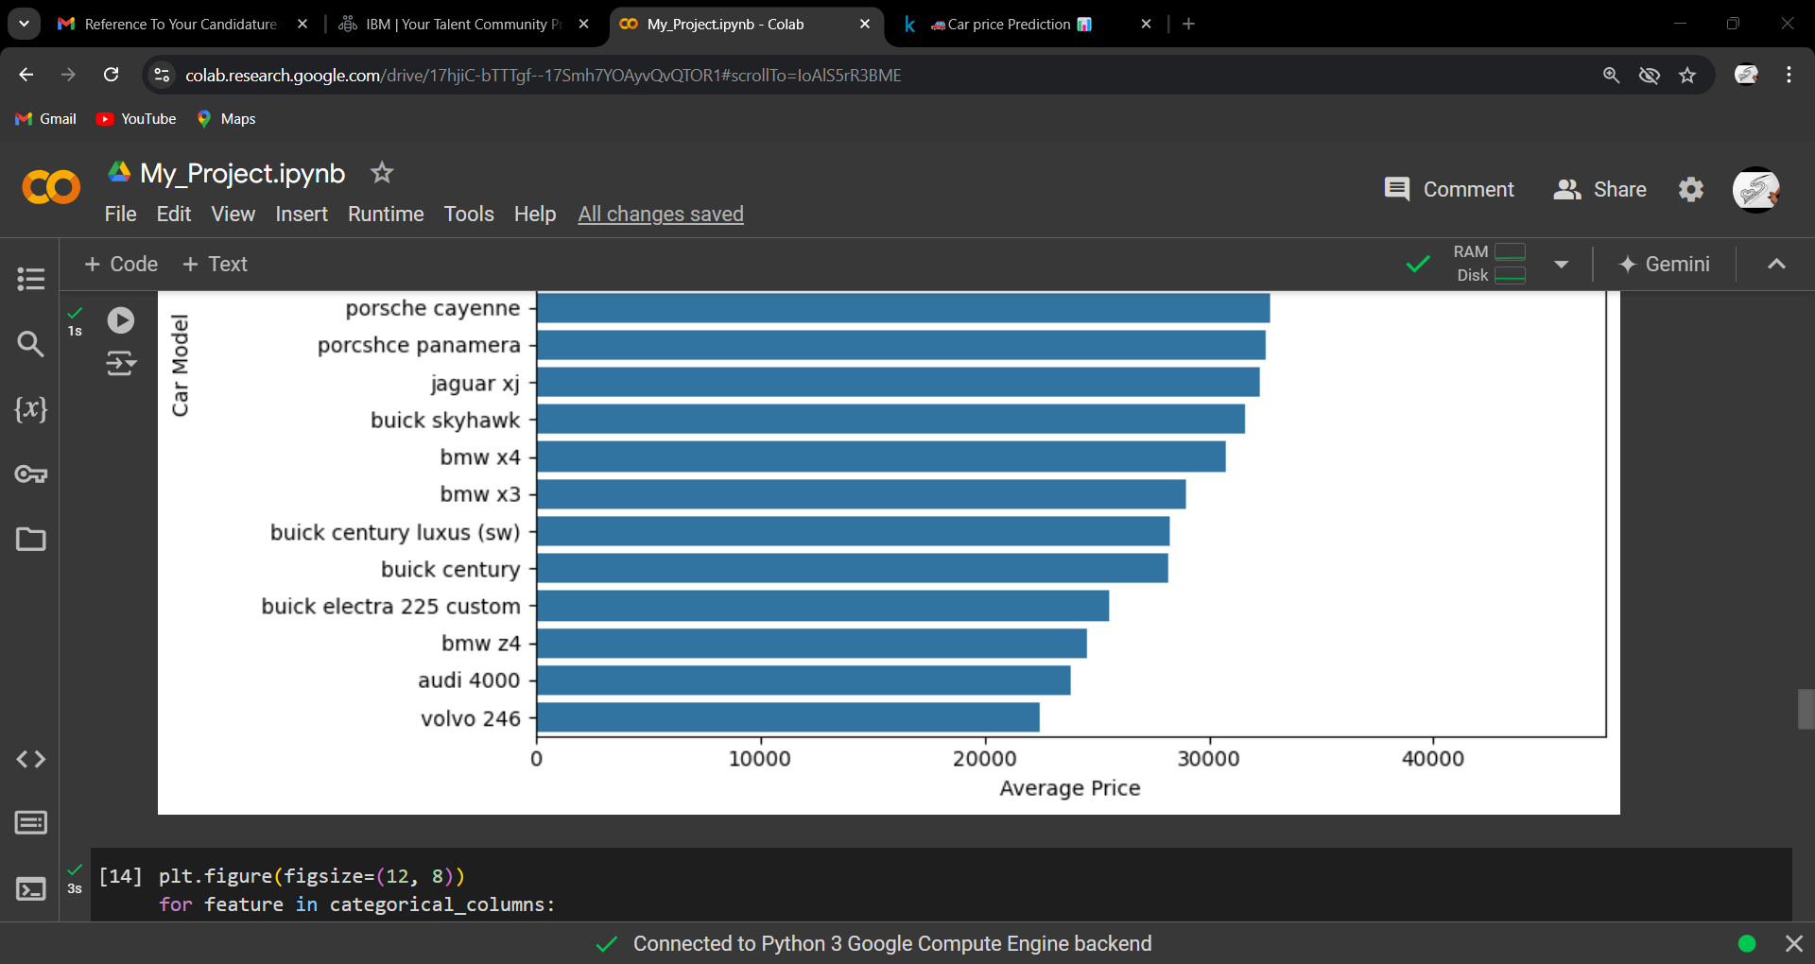
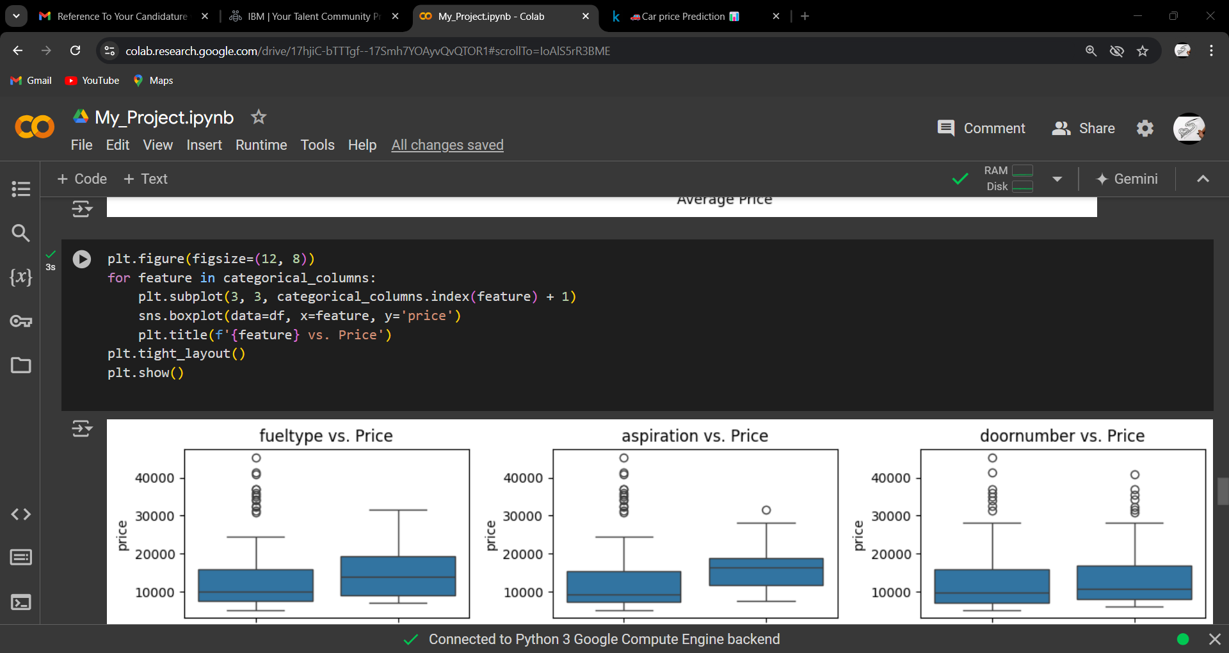

Slide 23
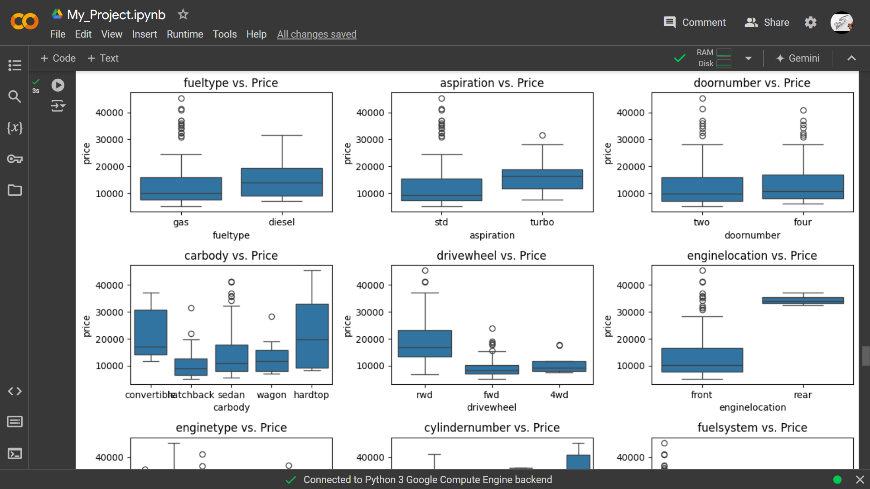
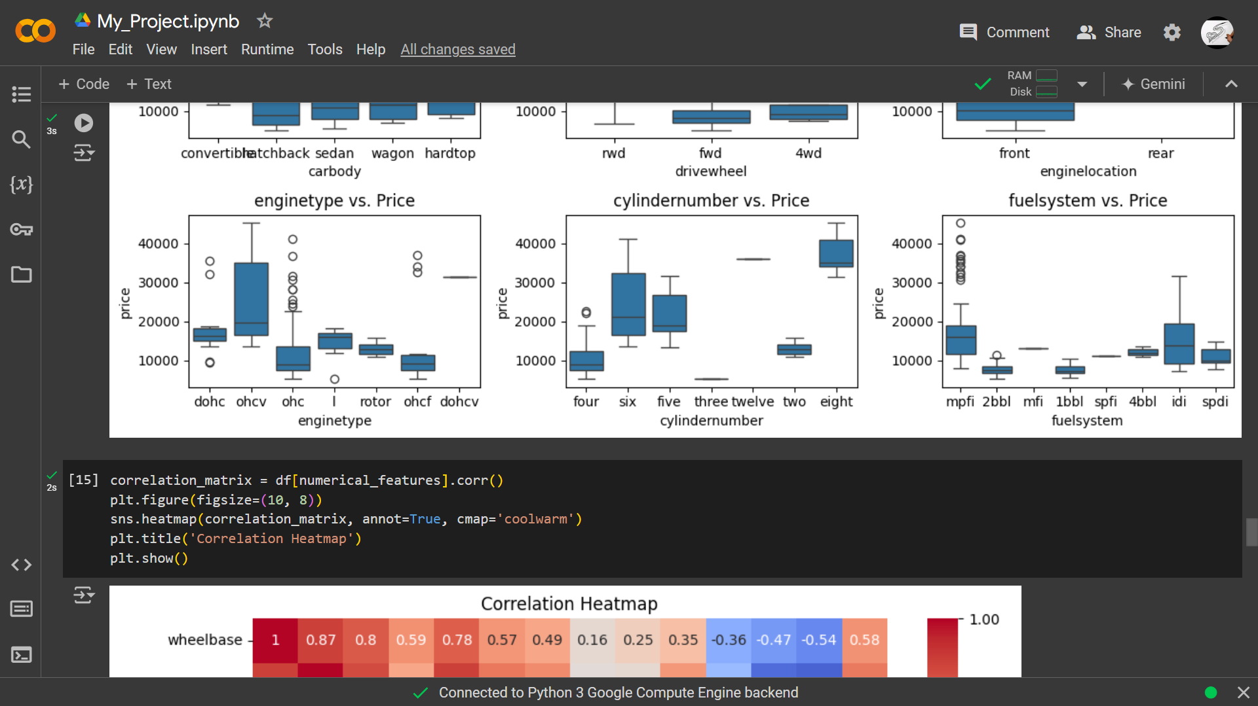

Slide 24
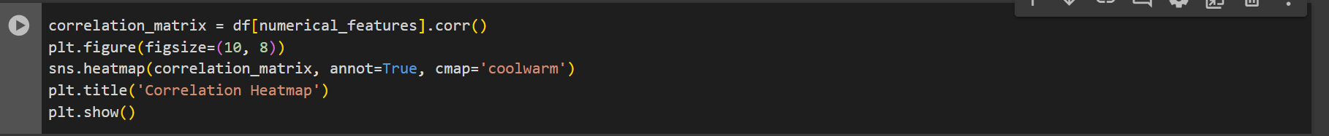
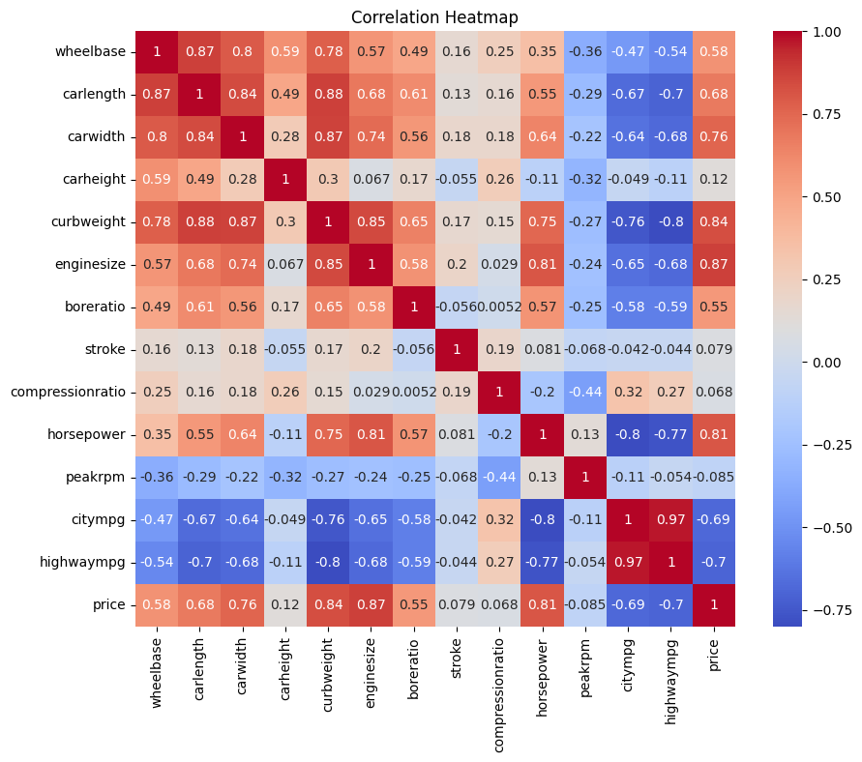

Slide 25
Analysing Result
We have DataSet > Car Price
The Shape DataSet = (Rows = 205, columns = 26)
No null value
No Duplicated value
Some Analyst
Price cars
Avg price = $13,276
Min price = $5,118
Max price = $45,400
The famous or repeats car > Toyota
Most using car working in Gas around 90% and the average price less than the car working in Diesel.
some category using the car working in Diesel around 10%, but the average price is more than the car working on Gas.
Most cars stand around 82%, also the average price less for Turbo, with turbo cars comprising around 18%.
Approximately 56% of users drive cars with 4 doors, while 46% drive cars with 2 doors; sports cars maintain a similar average price.
Most people prefer the Sedan car type, while higher-priced types like Convertible and Hardtop are also popular choices.
Majority of users opt for [Front-Wheel Drive (fwd)]> for their cars, possibly due to its lower price.
The most common engine type is "ohc," correlating with lower prices.
When increasing the number of cylinders, the price tends to increase, though the majority of users stick with 4 cylinders.
As the engine size increases, so does the price. The wheelbase, car length, and car width have an effect on the price, but the car height doesn't seem to have any significant impact.

Slide 26
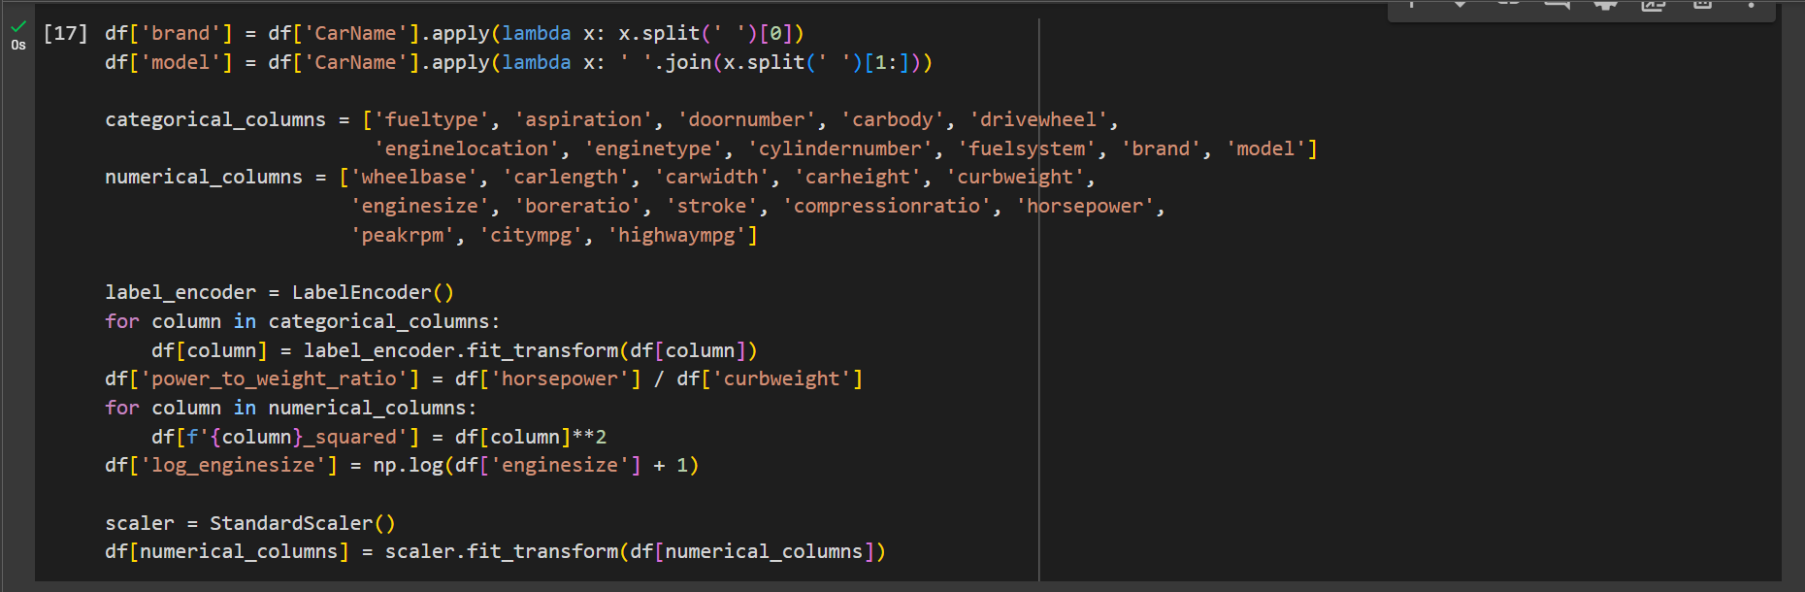
4.Data Pre-processing

Slide 27
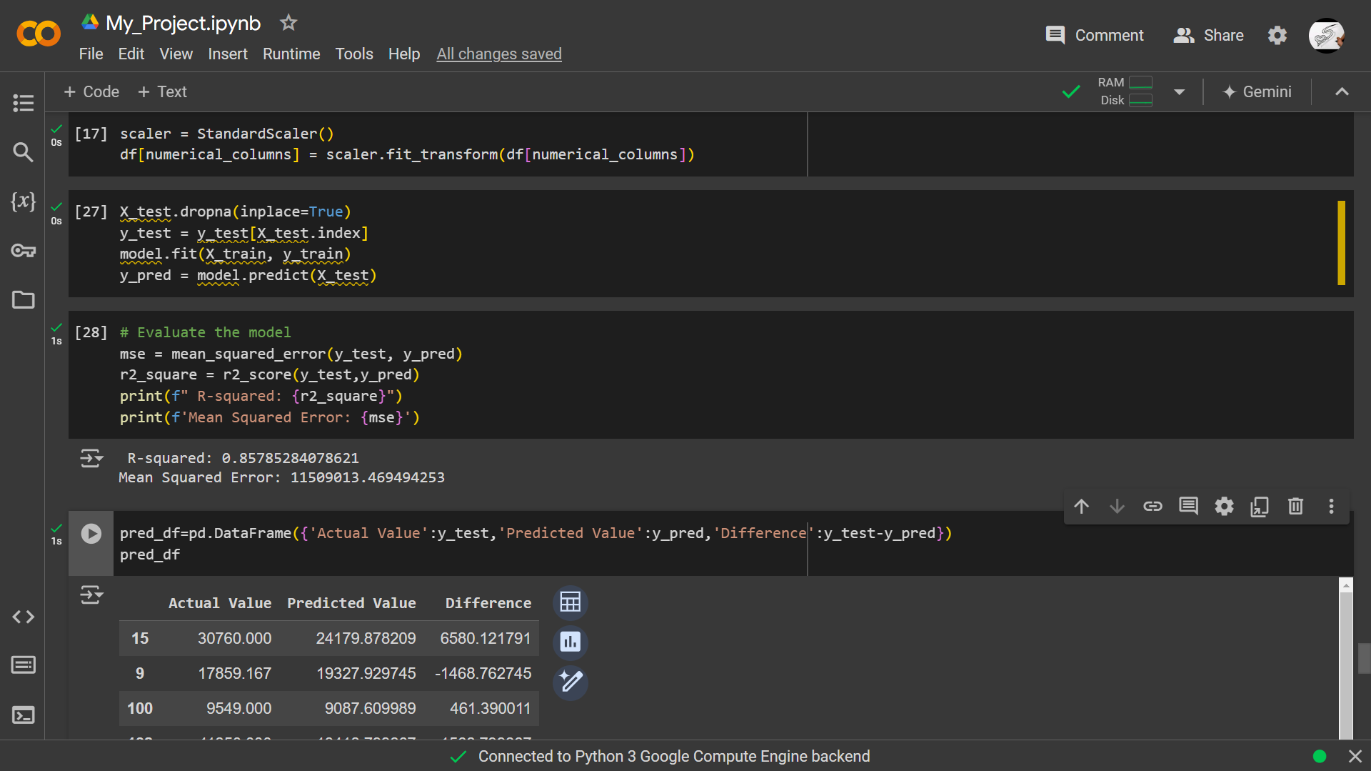
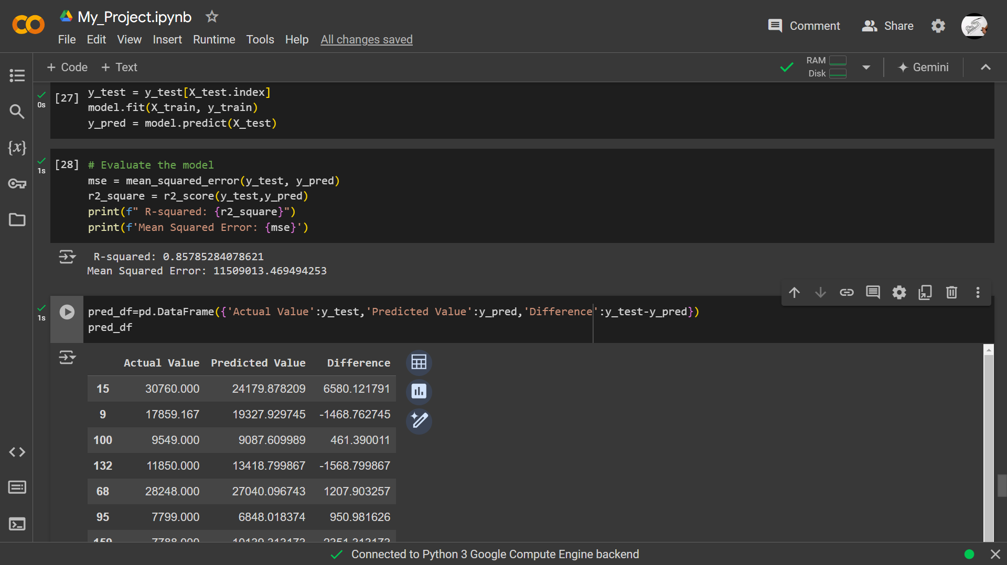
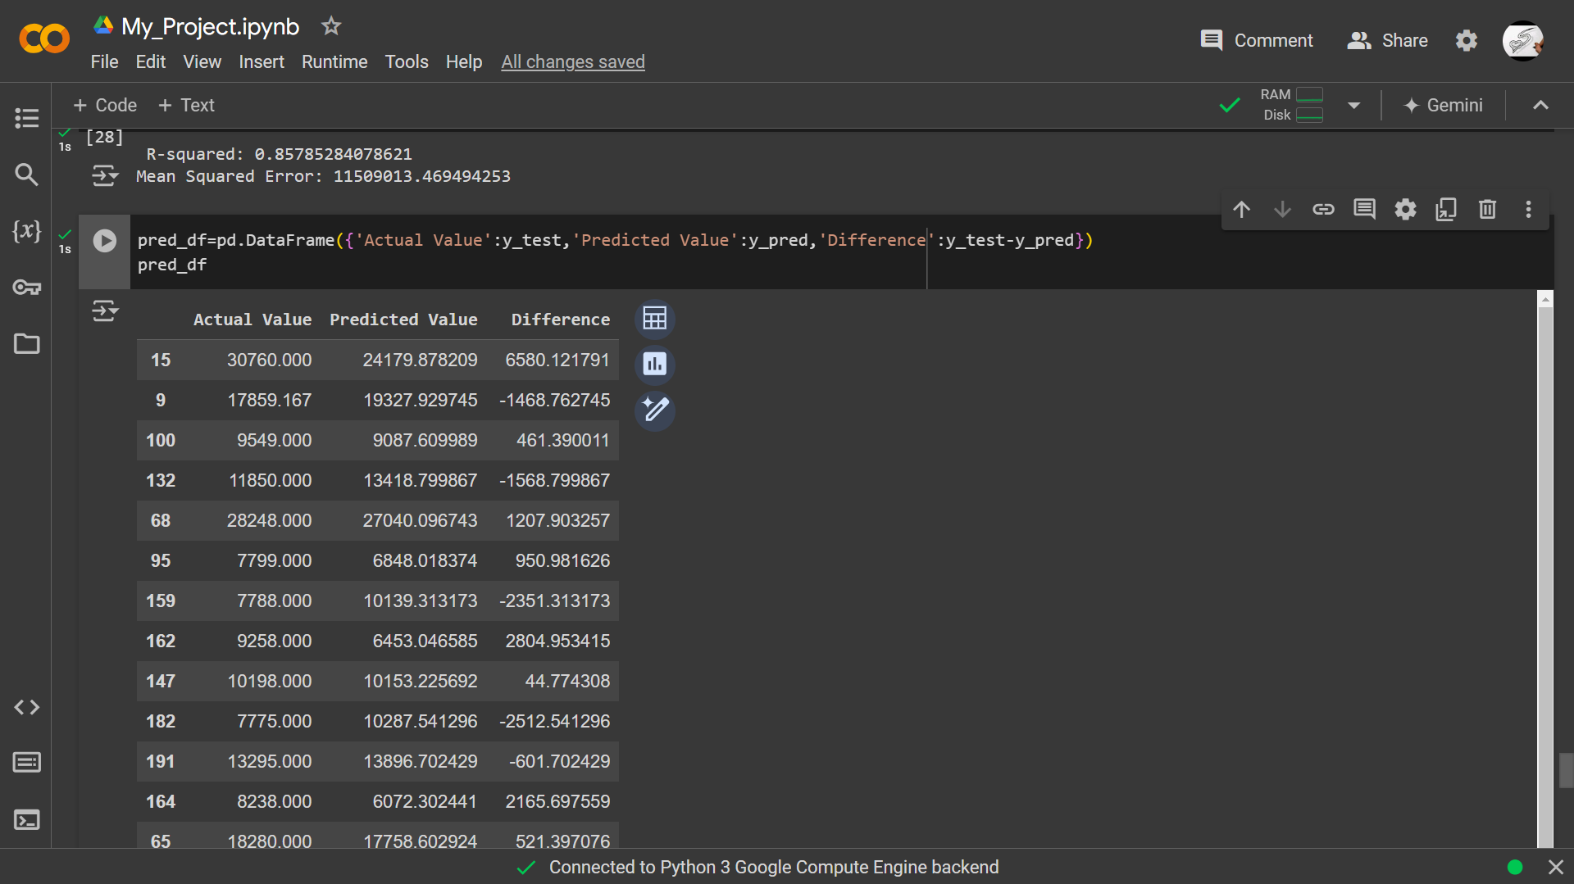
5.Train the Model

Slide 28
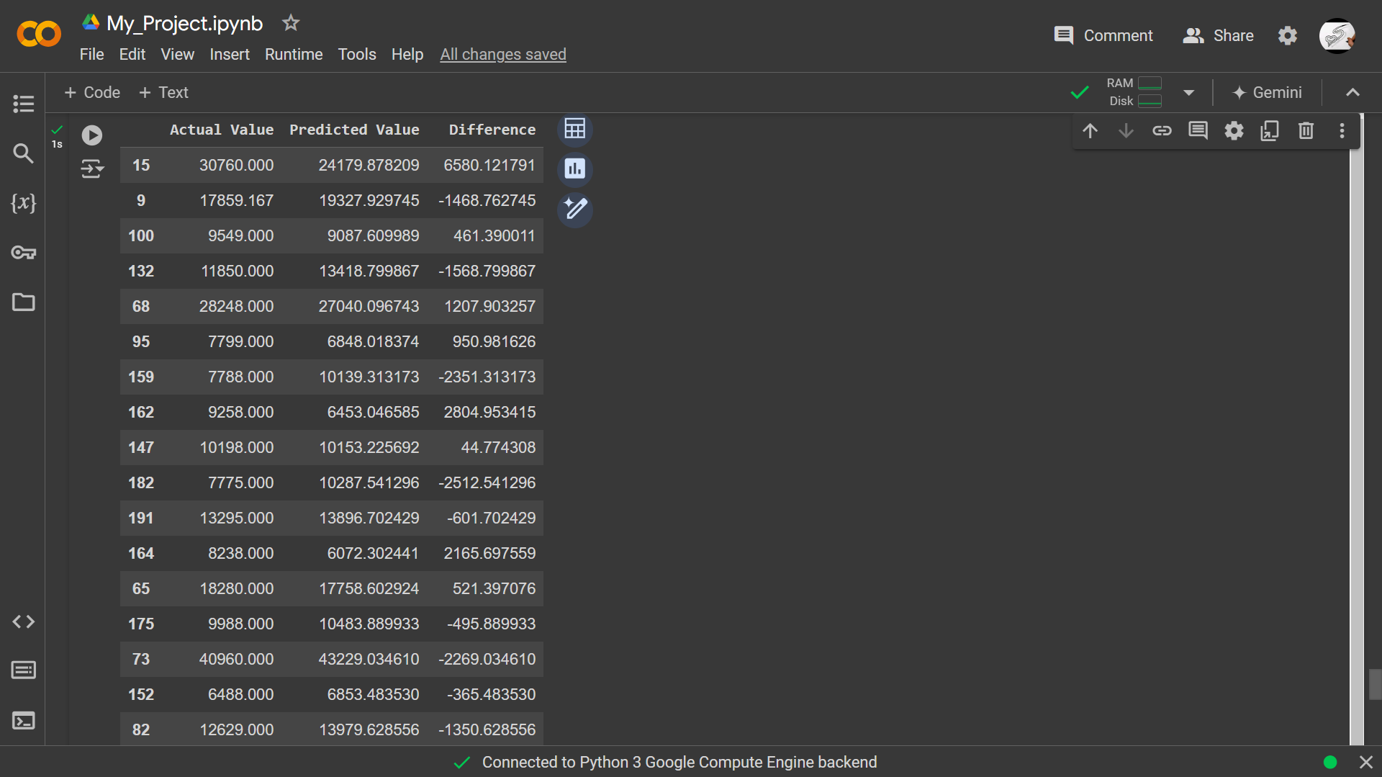
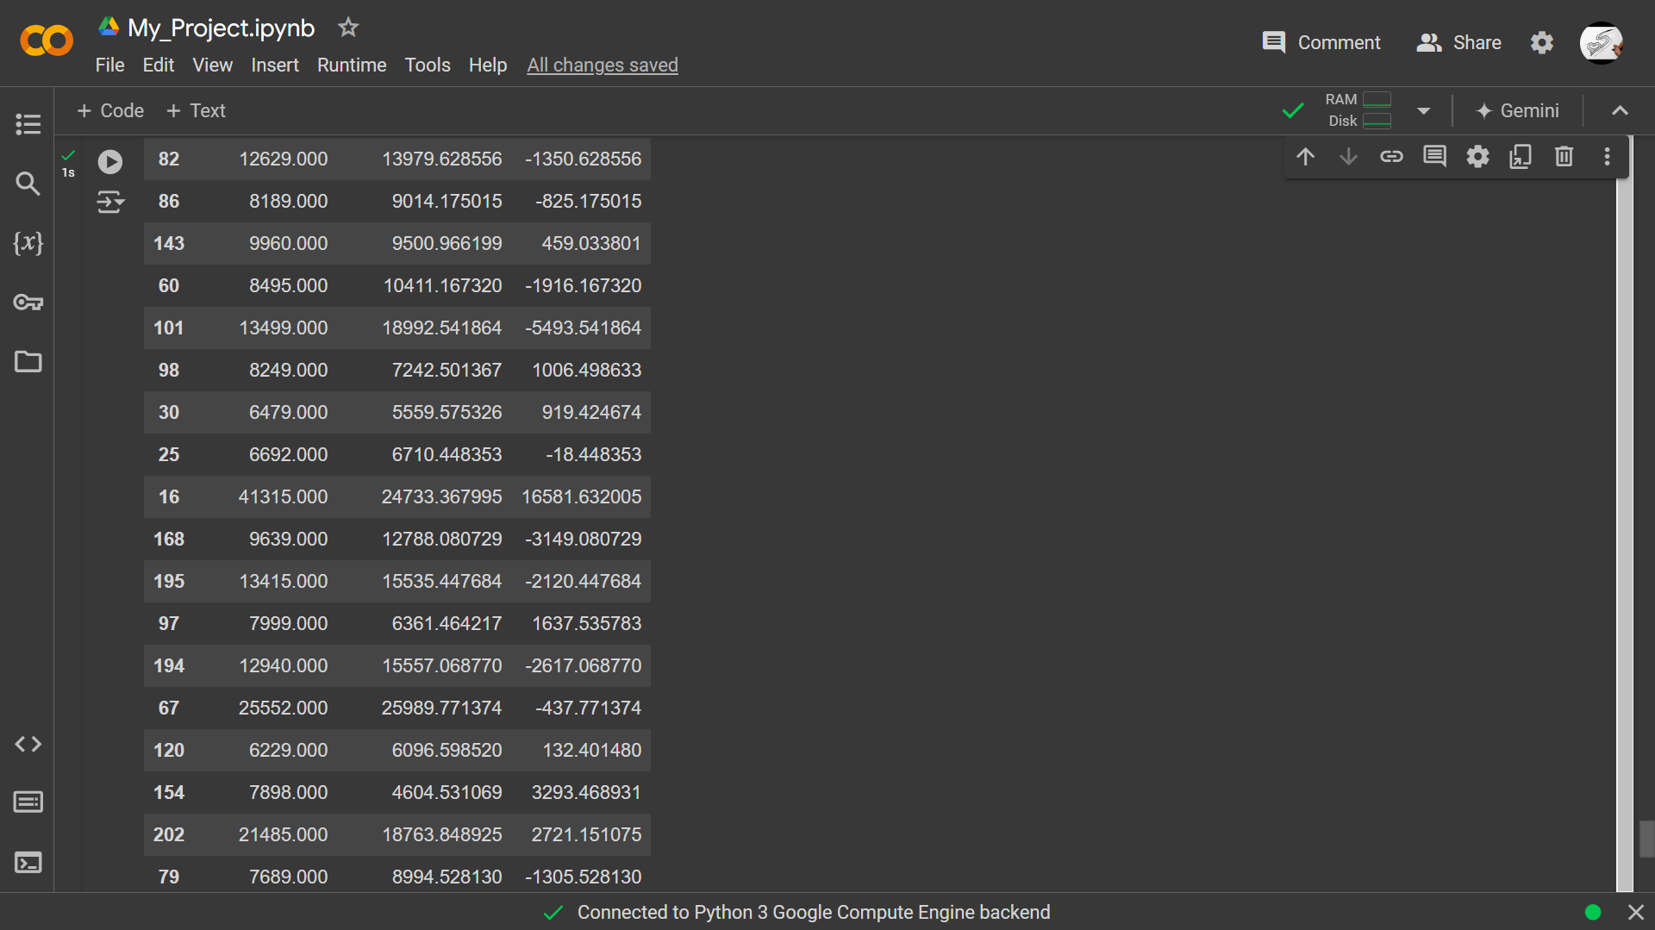

Slide 29
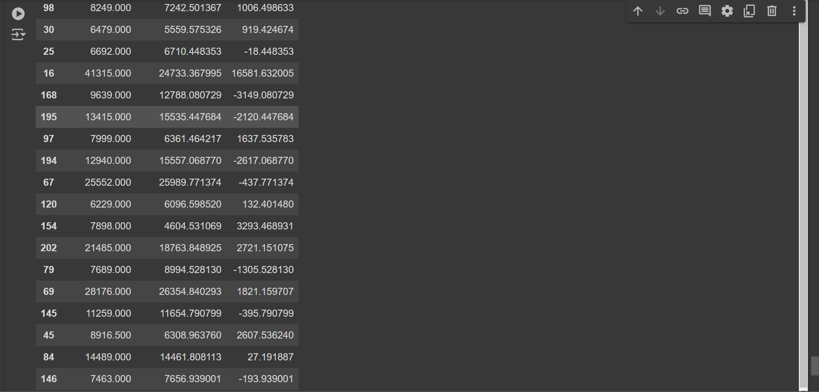

Slide 30
Final Result
Model Performance
Rejoice, for the R2 Score shines at an impressive 86.1%
Model Rankings
Linear Regression: Takes the lead with a solid 86.1% performance.
So , the best model Linear Regression 87.1
Notes
Thank for reading my analysis and my regression.
If you any questions or advice me please write in the comment .
If anyone has a model with a higher percentage, please tell me
Links : https://colab.research.google.com/drive/17hjiC-bTTTgf--17Smh7YOAyvQvQTOR1?usp=sharing
The End

